Slide 1
White-tailed Deer
Biology and Adaptations
http://webcache.googleusercontent.com/search?q=cache:Bf2uvnYbScYJ:sfr.psu.edu/youth/sftrc/deer/white-tailed-ppt+white+tailed+deer+biology+and+adaptations,+ppt&cd=2&hl=en&ct=clnk&gl=us
PA Game Commission
Notes:
White-tailed deer – Pennsylvania’s State Mammal

Slide 2
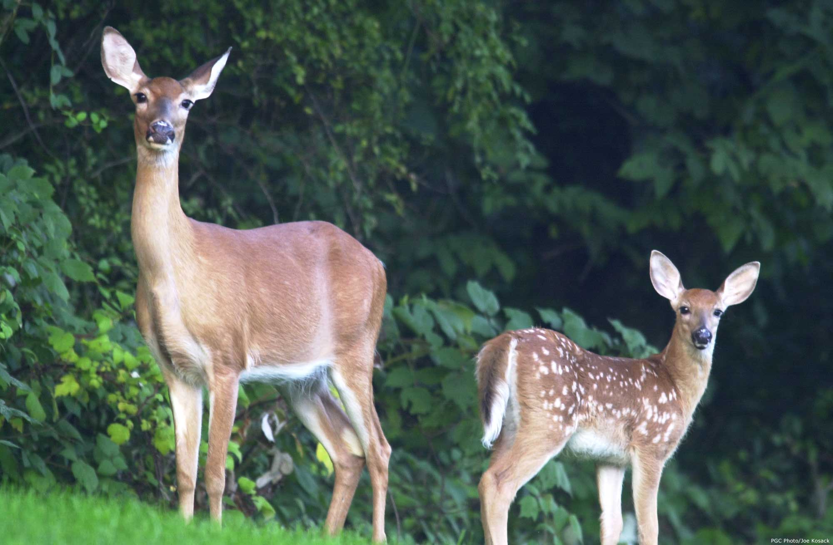
White-tailed Deer
Biology and Adaptations
By David R. Jackson
Penn State Cooperative Extension
March 2008
PA Game Commission
Notes:
White-tailed deer – Pennsylvania’s State Mammal

Slide 3
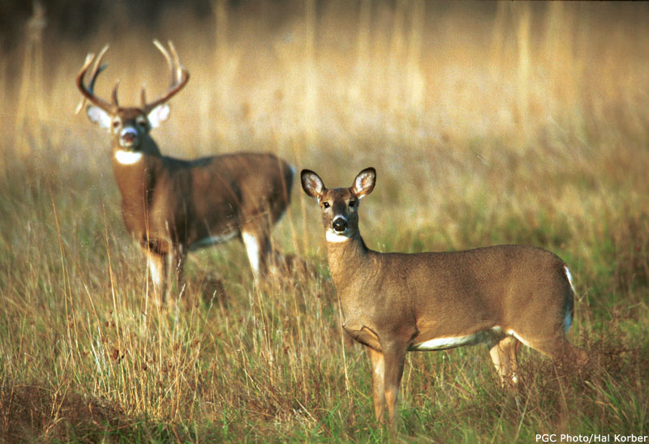
White-tailed deer: Odocoileus virginianus
Notes:
Identification:
Also known as the Virginia deer or simply as the whitetail.
The male, also know as a buck, weighs from 130 to 220 pounds. In rare cases males in excess of 350 pounds have been recorded. The average adult buck in Pennsylvania weighs about 140 lbs. live weight and stands 32-34 inches at the shoulder.
The female, known as the doe, usually weighs from 90 to 130 pounds.
Males one year of age and older have antlers. Bucks with very small antlers are often called button bucks.

Slide 4
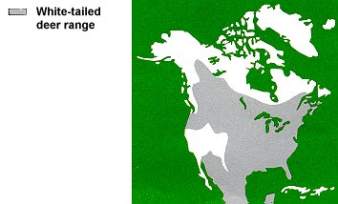
White-tailed deer are the most widely distributed
large animal in North America.
White-tailed
deer range
Hinterland Who’s Who
Notes:
Range:
White-tailed deer are found throughout most of the continental United States, southern Canada, Mexico, Central America, and northern portions of South America as far south as Peru.
The species is absent from much of the western United States, including Nevada, Utah, and California (though its close relatives, the mule deer and black-tailed deer, can be found there).
It survives in aspen parklands and deciduous river bottomlands within the Central and Northern Great Plains, and in river valley bottomlands, and lower foothills of the Northern Rocky Mountain Regions from Wyoming to Southeastern British Columbia. The conversion of land adjacent to the Northern Rocky Mountains into agriculture use and partial clear-cutting of coniferous trees (resulting in widespread deciduous vegetation) has been favorable to the white-tailed deer.
There are also populations of Arizona (coues) and Carmen Mountains (carminis) white-tailed deer that inhabit the mountain mixed deciduous/pine forests of Arizona, New Mexico, and West Texas extending southwards into Mexico.
(Source: Wikipedia.com)

Slide 5
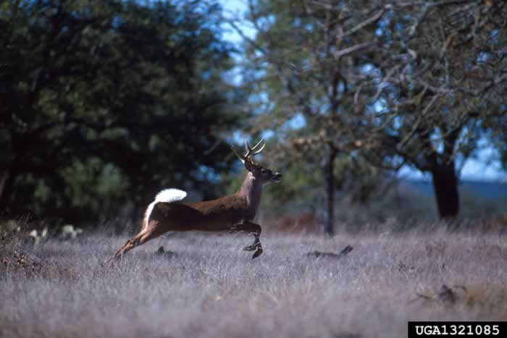
Named for the white hairs on the underside of it’s
tail. When startled by danger and fleeing an area
whitetails “flag” their tails as a warning signal.
Scott Bauer, USDA ARS, www.forestryimages.org
Notes:
The white-tailed deer was so named because the underside of its tail is covered with white hair.
When startled by danger and fleeing an area, whitetails often hold their tails erect so that the white undersurface is visible.
This acts as a warning signal for other deer.

Slide 6
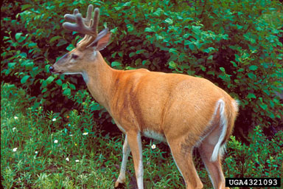
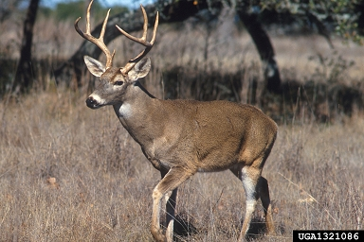
The whitetails coat is reddish brown in summer and
turns to a gray brown in fall and winter.
Summer Coat
Winter Coat
Kenneth M. Gale, , Bugwood.org
Scott Bauer, USDA Agricultural Research Service, Bugwood.org
Notes:
During the summer, the upper parts of the whitetail’s body are reddish brown. The hairs are short, thin, and wiry.
In winter the whitetail’s coat is grayish brown. The hairs are long, thick and hollow.
In winter, air filled hairs provide extra insulation against the cold.

Slide 7
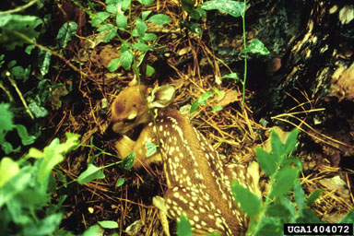
A fawns spotted coat serves as camouflage. The spots imitate sunlight hitting the forest floor.
Dale Wade, Rx Fire Doctor, Bugwood.org
Notes:
Fawns are reddish brown with white spots to help camouflage them.
The mother leaves the fawns well-hidden for hours while she feeds nearby.
While they are waiting for their mother to return, the fawns lay flat on the ground making it difficult for predators to find them.
The fawns take on the same color coat as the adults in the fall.

Slide 8
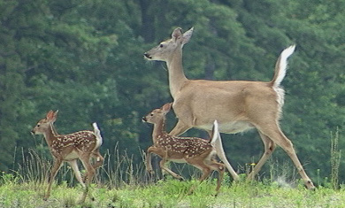
Most fawns are born during May and June.
In good habitat, does generally have twins.
www.mynaturephotos.com
Notes:
Most fawns are born during May and June. However, birth can take place from March to early August
Fawns can stand within minutes after being born, taking its first nourishment from the doe’s rich milk.
In good habitat most does give birth to twin fawns. Younger does generally have just one fawn.
Some females are capable of reproducing at age 7 or 8 months of age but most when they are 1 ½ years old.

Slide 9
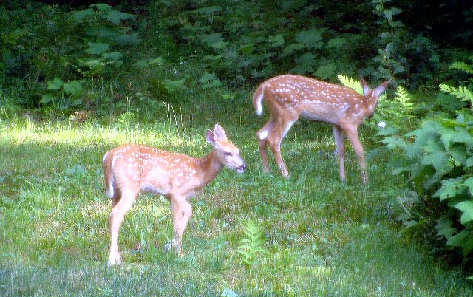
Fawns will eat blackberries in the same place where
it sees its mother eating blackberries.
Notes:
This is an acquired trait

Slide 10
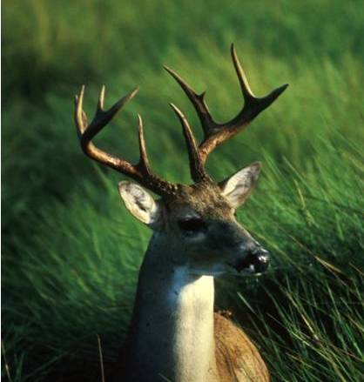
A whitetail’s keen senses of smell, vision, and hearing help them detect danger from predators including bear, coyotes, bobcats, and humans!
John Stehn, U.S. Fish and Wildlife Service
Notes:
A whitetail’s keen senses help them detect danger.
Smell – Few animals have a better sense of smell than the whitetail.
A large portion of whitetail’s brain is devoted to odor reception and interpretation
Vision – Whitetails have excellent vision in low light or darkness, strong peripheral vision, and can easily detect motion. Whitetails are color-blind and have difficulty detecting stationary objects.
The eyes are located on the sides of its head allowing it to scan nearly 180 degrees.
A whitetail’s retina is dominated by rod or light receptor cells making it 1000 times more sensitive to light.
The retina also has a reflective pigment called the tepatum which reflects light back to the retina.
The whitetail’s pupil opens much wider than a humans allowing it to gather 9 times more light
Hearing – large, cupped external ears gather and amplify sound.
A whitetail’s ears are able to rotate in different directions enabling it to pinpoint sources.

Slide 11
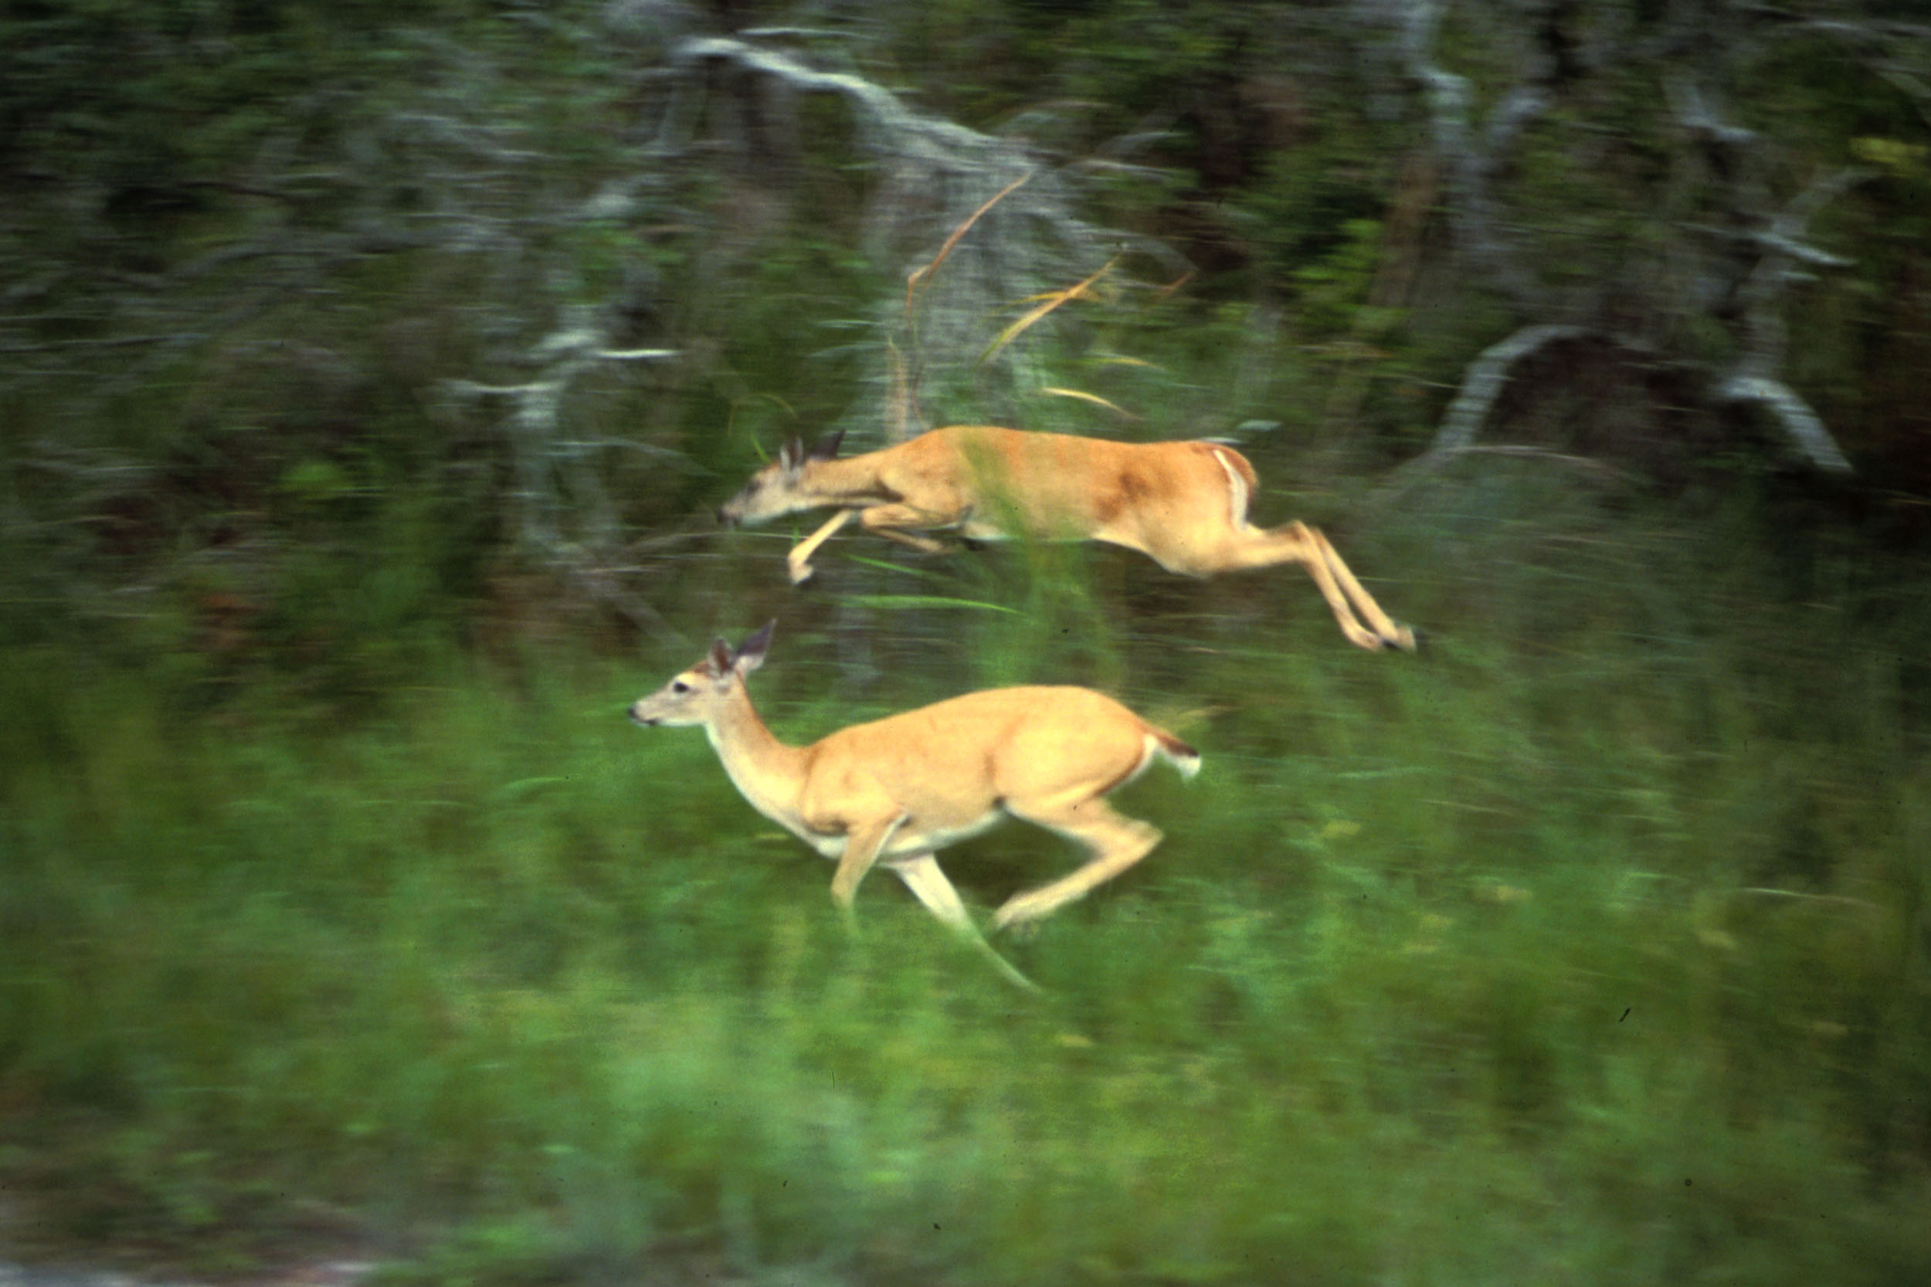
Whitetails can run and bound through dense
vegetation at 40 miles per hour.
U.S. Fish and Wildlife
Notes:
Whitetails can run at 40 miles per hour for short bursts and maintain speeds of 25 miles per hour for longer periods
Whitetails are also good jumpers capable of clearing obstacles up to nine feet high or 25 feet wide.

Slide 12
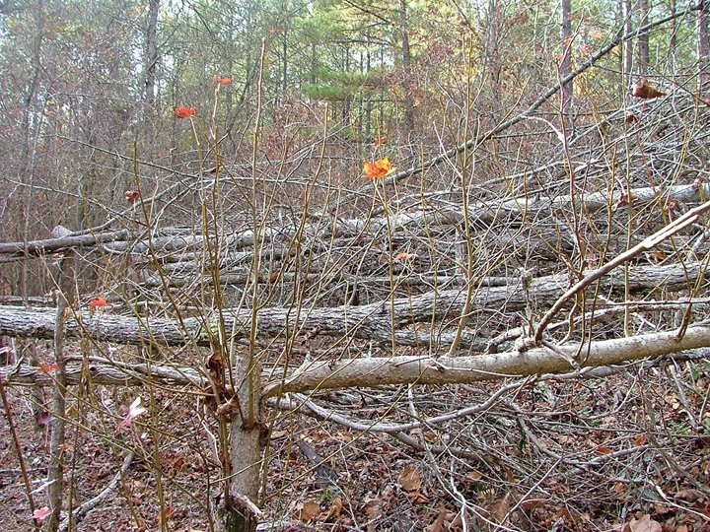
Deer will find camouflage in thick areas of vegetation to sleep in.
Notes:
This is an acquired trait.

Slide 13
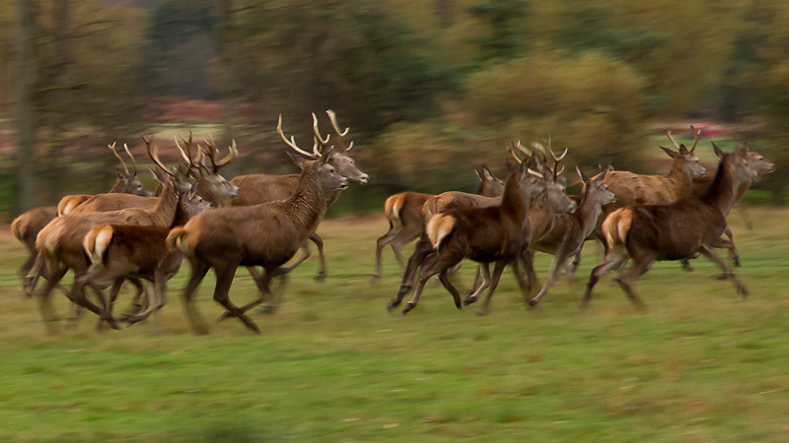
A herd of deer will run away when they hear
a hunter’s gun shot.
Notes:
This is an acquired trait.

Slide 14
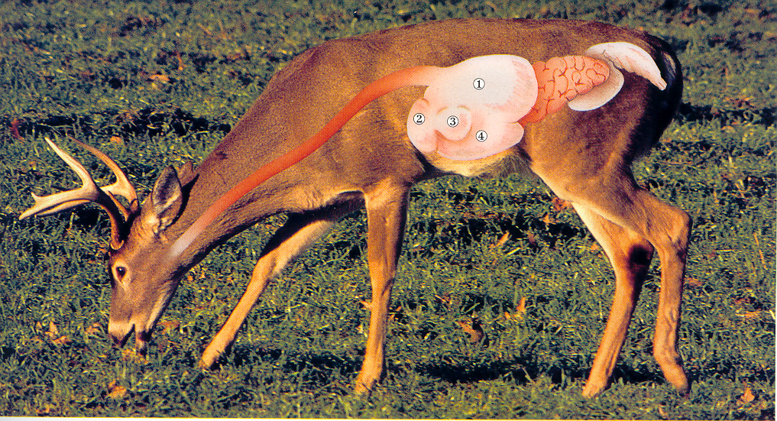
White-tailed deer, like cows, are ruminants or “cud” chewers.
They have a 4 chambered stomach. The first chamber,
called the rumen, stores food which is later regurgitated,
chewed, and swallowed.
The Hunting and Fishing Library
Notes:
Whitetails gulp food without chewing allowing them to consume large amounts of food in a short period of time.
This behavior allows them to fill up in a short period of time while avoiding the danger of predators.
Once bedded in cover, the whitetail then regurgitates the food, chews it, and swallows it allowing it to pass through the other chambers of its stomach for further digestion.
The four chambers of a deer’s stomach include (1) the rumen, (2) the reticulum, (3) the omasum, and (4) the abomasum.
The rumination process allows deer to eat a wide variety of plant material.
A Pennsylvania study, which involved the examination of food contained in the rumens of vehicle killed deer, identified 98 different plant species.

Slide 15
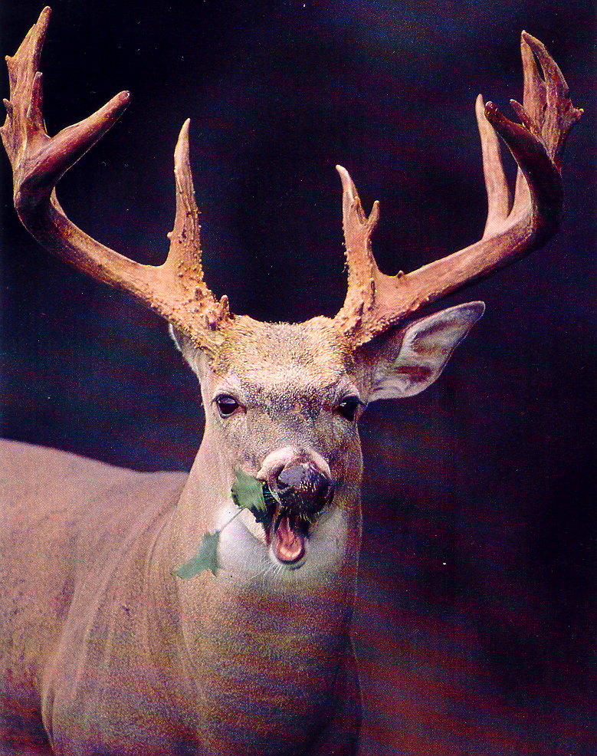
Deer are predominantly browsers feeding on leaves, buds, and twigs. An average adult deer requires 4-8 pounds of forage per day.
Hunting and Fishing Library
Notes:
Whitetails are predominantly browsers feeding on woody plants that grow in the forest understory.
Seedlings and saplings provide food in the form of buds, leaves, and stems.

Slide 16
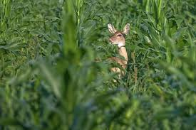
Deer will move to a field where it can eat
the new growth of corn.
Notes:
This is an acquired trait.

Slide 17
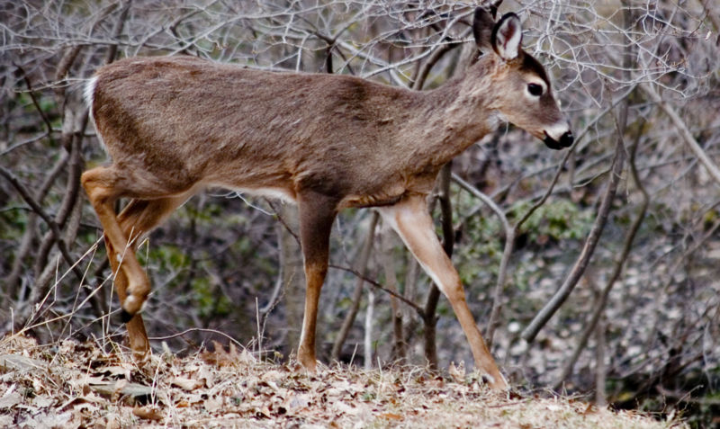
In heavily hunted areas deer rarely live past 3
years of age. Where hunting pressure is light
deer may live to be 10 years of age.
http://en.wikipedia.org
Fawns can be recognized by their shorter facial features.
Notes:
To set hunting regulations a biologist must determine the age structure of the herd
Fawns are deer less than one year of age.

Slide 18
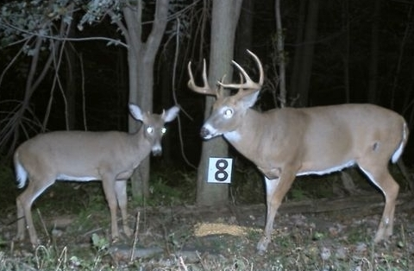
Antler and body size is used to estimate a
whitetail’s age. Here, a six month old “button” buck is
shown beside a mature 4-1/2 year old buck.
J. Snavely
Notes:
Antler and body size are good indicators of a whitetail's age, but physical characteristics can be misleading.
Physical characteristics may also be a reflection of habitat conditions.
The number of antler points in no way corresponds to age.

Slide 19
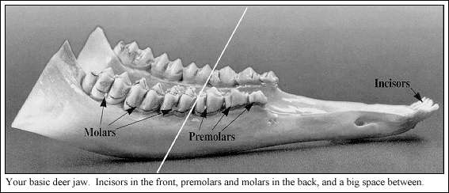
The pattern of tooth replacement and wear is
used by biologists to determine a whitetail’s age.
USGS, Northern Prairie Wildlife Research Center
Notes:
A trained biologist looks at both the type of teeth the deer has as well as how worn they are. After all of the white-tail's permanent teeth have come in, biologists look for the amount of wear on the molars.

Slide 20
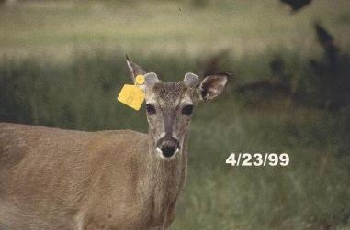
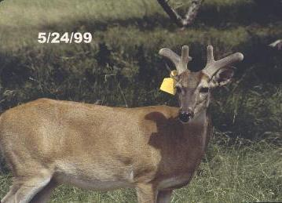
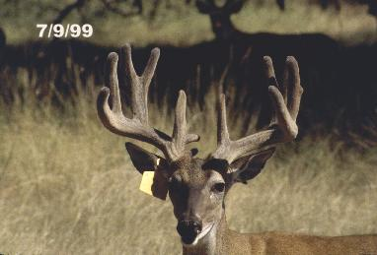
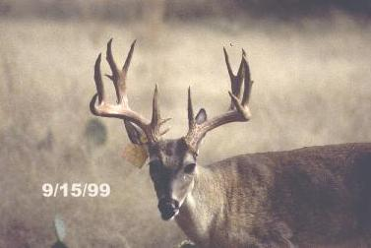
A bucks antlers are covered with “velvet” while they are growing.
Texas Parks and Wildlife
Notes:
A whitetail’s antlers grow from an area on top of the skull known as the pedicel.
Antlers are composed primarily of calcium, phosphorus and other minerals
Bucks develop and shed new antlers each year. Antlers generally begin to grow in March or April.
The growing antler, which is the fastest growing form of true bone, is covered with a soft, hair-covered membrane known as "velvet". The velvet is interlaced with numerous blood vessels that transport and deposit minerals that build the antler.
By August or early September antler growth ceases and the velvet is shed or rubbed off.
The antlers are shed in January or February and a new set begins to grow in the spring.

Slide 21
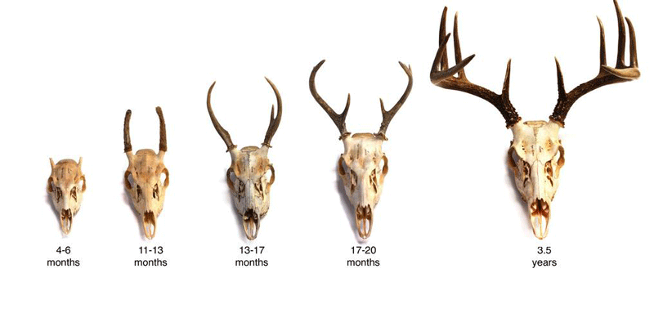
Many factors affect a whitetail’s antler development, including: 1. Diet - Nutrition 2. Age 3. Genetics 4. Herd Management
http://www.deerhunting.ws/deeraging.htm
Notes:
Antler size development is affected by nutrition, age, genetics, and herd management.
Nutritional intake is used for antler growth only after the body growth requirements are met
Most deer don’t produce their largest set of antlers until after 4^{1/2} years of age.
To ensure an abundance of high quality food, herd size must be kept in balance with the habitat. This often requires the harvest of does.

Slide 22
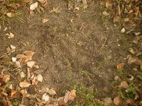
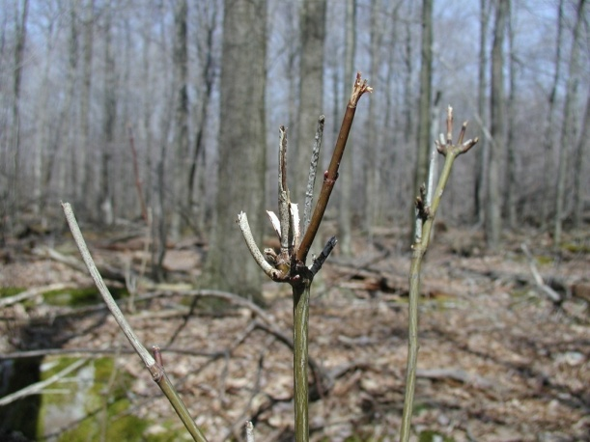
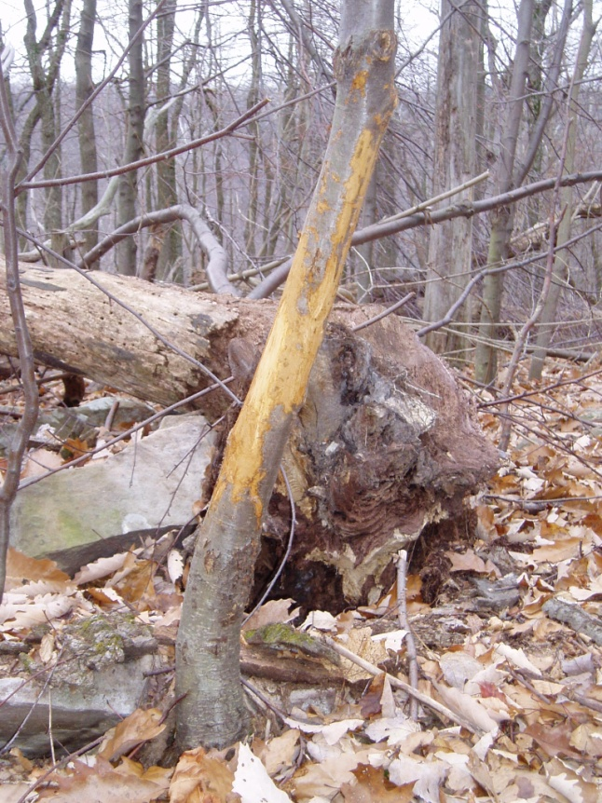
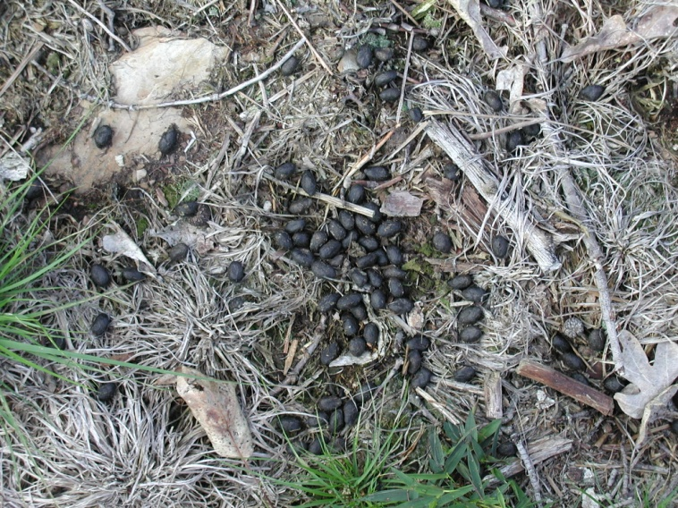
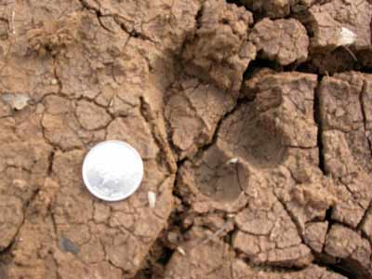
Whitetails leave many signs behind as evidence of their presence.
Ground Scrape
Browse
Buck Rub
Rich Geffert
D.R. Jackson
Droppings
Track
S.S. Smith
D.R. Jackson
A. Moors CouesWhitetail.com
Notes:
Buck rubs - Bucks mark their territory by removing bark from trees with their antlers. This is called a "buck rub." Look for buck rubs on trees from September to November. Buck rubs are usually one to two feet high off the ground.
Browsing Sign - Frayed twig ends are a good sign of whitetail feeding activity. Since whitetails lacks upper front teeth the end of the branch is torn off leaving a ragged end.
Tracks - Whitetail tracks are heart-shaped. The track is made by two hooves, also called toenails. The pointed end of the track points to where the deer was going.
Ground Scrapes – Scrapes are made when the deer paws the ground to the bare earth. Scrapes are always made near a small tree or overhanging branch. The buck rubs his head on the tree and licks or rubs the branch leaving more of his scent. A scrape is a definite sign that a buck is using the area.
Droppings - Whitetail feces are usually elongated and for the most part tightly grouped. They are usually dark brown or black in color and soft and moist when fresh.
Trails - Whitetails travel in narrow paths called trails. Trails usually connect where the whitetail eats and where it rests.
Beds - Just like your bed at home, whitetails have places on the ground where they lay down to rest. Beds are usually surrounded by plants or shrubs to protect the deer from rain or snow. Beds are easy to spot in the snow. Whitetail beds are generally 3-4 feet long and 1 ½ feet wide.
Shed Antlers - Sheds are usually found in spring in the area where the buck wintered. Shed antlers provide proof that a buck made it through the hunting season.
Wisconsin DNR, http://www.dnr.state.wi.us/org/caer/ce/eek/critter/mammal/fawn.htm
Scouting for White-tailed Deer, http://home.adelphia.net/~geffert/scouting.htm

Slide 23
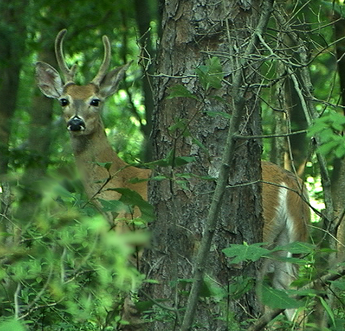
Whitetail Habitat
Food - consists of an abundant supply of grasses, forbs, browse, nuts, fruit, and crops
Water - generally not a limiting factor, obtain much of what they need from the plants they eat
www.mynaturephotos.com
Cover - necessary to elude hunters and other
predators and for protection from the weather
Space - area required to escape predators,
locate a mate, and find sufficient food, water and
cover
Notes:
Whitetails, and all wildlife, have four basic requirements, all of which are combined to form the habitat for the species.
These include food, cover, water, and space.
If one of these basic needs is inadequate in an area, then the whitetails survival in that location is compromised.
Food - With proper nutrition whitetails have higher reproductive rates, are more resistant to disease, and are better able to escape predators.
Water - Whitetails drink water when it is available but can go an extended time without drinking. They can obtain much of the water they need from the plants they eat.
Cover – This is necessary for breeding, hiding, sleeping, feeding, weather protection, and traveling. The best cover will stay year round and also provide other needs such as food.
Space – This is required to move about, avoid or escape predators, locate a mate, and obtain sufficient food, water, and cover. The amount of space required is determined by quantity and quality of food, cover, and water found in an area, the habitat.

Slide 24
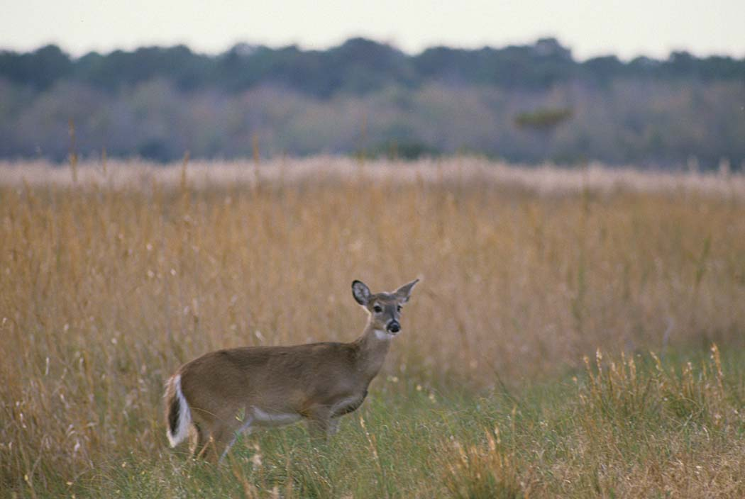
A young seedling/sapling forest provides excellent habitat. Whitetails also prefer “edges” or transition areas between fields and forests.
Donna Dewhurst, U.S. Fish and Wildlife Service
Notes:
White-tailed deer are able to survive in a wide variety of habitats from big woods to mixed farmland and woodlots.
Ideal habitat contains dense thickets to hide and move about and edges – zones between two different types of habitat, ex. forest and field – to furnish food.
Patchworks, rather than vast expanses of a single type of cover, support the greatest deer populations because they have more edge habitat.
Succession gradually changes habitat – a young forest is excellent for whitetails because it provides plenty of food and cover. As the forest matures the forest floor becomes shaded thus eliminating the plants that once provided food and cover.

Slide 25
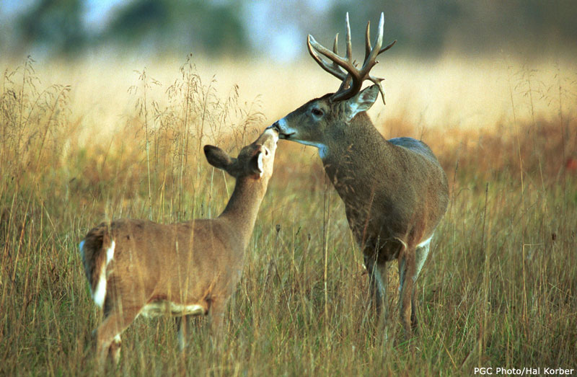
White-tailed deer are a valuable, renewable, natural resource that must be managed
Notes:
Without management, through hunting, deer can quickly overpopulate their range.
Population control is accomplished through the regulated harvest of male and female deer.
The Pennsylvania Game Commission issues hunting licenses and permits entitling hunters to harvest a specific number of deer within a given management unit.
Deer populations, and density goals along with hunter success rates are used to gauge how many hunting permits should be issued.
Maintaining healthy deer populations is a public asset to be enjoyed by future generations.

Slide 26
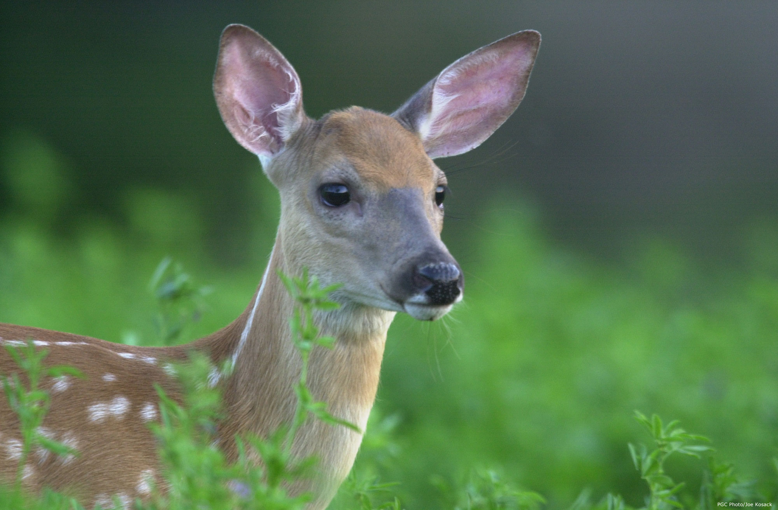
Questions
PA Game Commission
Notes:
Questions

Slide 27
This is about a very unusual
herd of deer found in
Wisconsin near the border
with Michigan's Upper
Peninsular.
Watch and listen and enjoy.
http://www.pbs.org/wgbh/pages/frontline/video/flv/generic.html?s=inwi10s22a3q81f
PA Game Commission
Notes:
Questions

