Slide 2
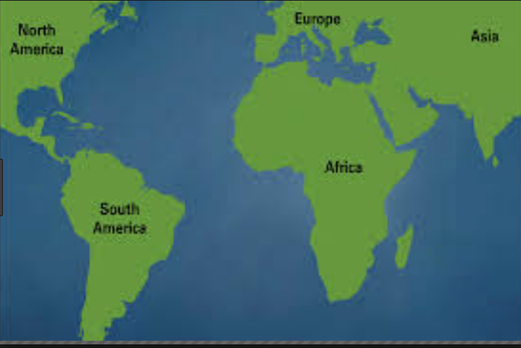
Bell Ringer
Do you think it is possible that at one time South America and Africa were joined together? How?
https://naturalhistory.si.edu/africanvoices/voices.html

Slide 3
I can explain how plate tectonics change the Earth’s surface over time and how we can predict natural hazards and/or catastrophic events.

Slide 4
Continental Drift Pangaea & Seafloor Spreading

Slide 5
Continents
https://en.wikipedia.org/wiki/Continent

Slide 6
Continental Drift definition
The theory that continents can drift apart from one another and have done so in the past.

Slide 7
Open your books to page 173-174

Slide 8
Notes

Slide 9
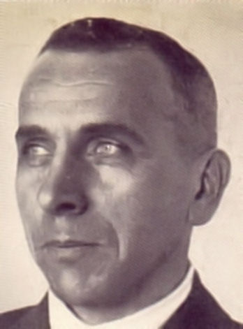
Part 1: A Controversial Theory
In a 1912 lecture, German born meteorologist Alfred Wegener proposed the idea of continental drift.
"Alfred Wegener" by Bildarchiv Preussischer Kulturbesitz, Berlin, Bildid #10005753. Licensed under Public Domain via Wikimedia Commons - https://commons.wikimedia.org/wiki/File:Alfred_Wegener.jpg#/media/File:Alfred_Wegener.jpg

Slide 10
Part 1: A Controversial Theory
His idea came from 2 observations
FIRST OBSERVATION:
The continents seem to fit together like a puzzle
"Alfred Wegener" by Bildarchiv Preussischer Kulturbesitz, Berlin, Bildid #10005753. Licensed under Public Domain via Wikimedia Commons - https://commons.wikimedia.org/wiki/File:Alfred_Wegener.jpg#/media/File:Alfred_Wegener.jpg

Slide 11
Part 1: A Controversial Theory
SECOND OBSERVATION
Fossils of animals found on coasts of different continents also aligned
"Alfred Wegener" by Bildarchiv Preussischer Kulturbesitz, Berlin, Bildid #10005753. Licensed under Public Domain via Wikimedia Commons - https://commons.wikimedia.org/wiki/File:Alfred_Wegener.jpg#/media/File:Alfred_Wegener.jpg

Slide 12
Part 1: A Controversial Theory
The original land mass he referred to as ‘Pangaea,’ meaning ‘all earth.’
"Alfred Wegener" by Bildarchiv Preussischer Kulturbesitz, Berlin, Bildid #10005753. Licensed under Public Domain via Wikimedia Commons - https://commons.wikimedia.org/wiki/File:Alfred_Wegener.jpg#/media/File:Alfred_Wegener.jpg

Slide 13
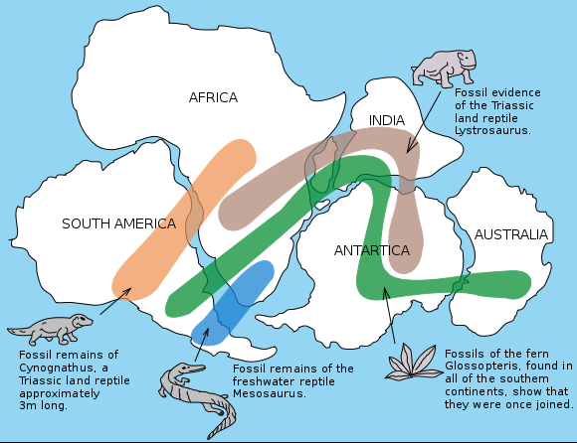
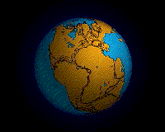
Continental Drift
"Snider-Pellegrini Wegener fossil map" by Osvaldocangaspadilla - Own work. Licensed under Public Domain via Wikimedia Commons - https://commons.wikimedia.org/wiki/File:Snider-Pellegrini_Wegener_fossil_map.svg#/media/File:Snider-Pellegrini_Wegener_fossil_map.svg
"Pangaea continents". Licensed under CC BY-SA 3.0 via Wikimedia Commons - https://commons.wikimedia.org/wiki/File:Pangaea_continents.png#/media/File:Pangaea_continents.png
"Pangea animation 03" by Original upload by en:User:Tbower - http://geomaps.wr.usgs.gov/parks/animate/A08.gif. Licensed under Public Domain via Wikimedia Commons - https://commons.wikimedia.org/wiki/File:Pangea_animation_03.gif#/media/File:Pangea_animation_03.gif

Slide 14
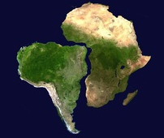
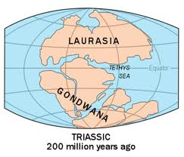
Ideas that supported Wegener
Puzzle pieces: the way
the continents fit together
Look how South
America and
Africa fit together.

Slide 15
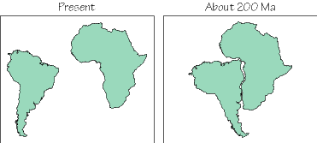

Slide 16
Ideas that supported Wegener
Fossil records: Locations of fossils on continents that would have fit together
Plant fossils and animal fossils.

Slide 17
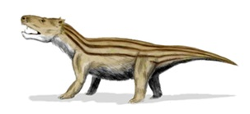
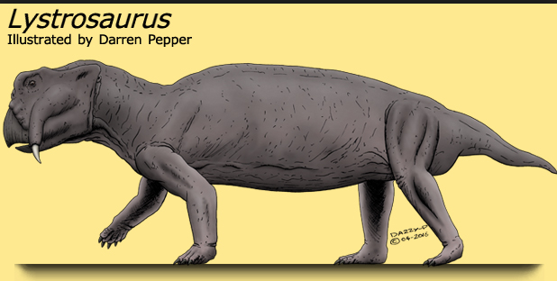
Mesosaurus fossils found in Africa & S. America
They could swim across ocean BUT the Mesosaurus only lived in fresh water.
So, even if it tried to swim across the Atlantic ocean it could not have lived long in salt water!
Cynognathus

Slide 18
A plot of fossil locations shows that Mesozoic land dwelling organisms occur on multiple continents. This would be hard to explain if continents were separated.

Slide 19
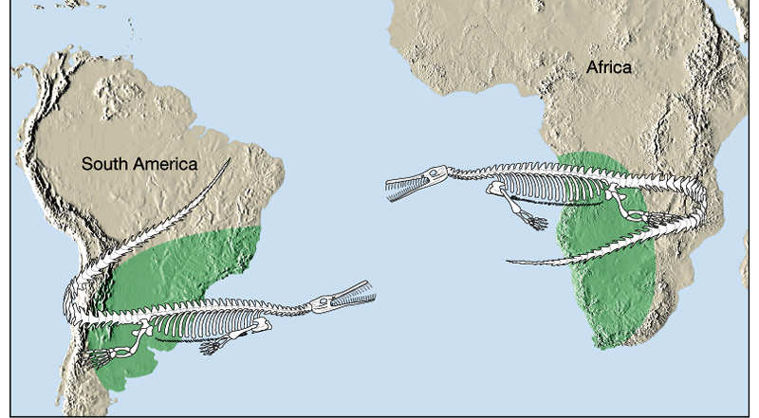
Mesosaurus fossils

Slide 20
Climate change: Plants that live primarily in warmer regions found on multiple continents, including Antarctica. If Pangea were true, the continent would have been in a warmer climate allowing for that plant to survive.

Slide 21
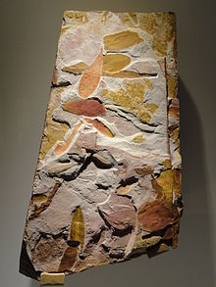
About those fossils….
The Glossopteris was a plant like a fern.
Found in S. America, Africa, Antarctica, Australia & India
Ferns usually grow in warm climates but Antarctica now covered in ice.
What does this tell you about the climate during time of Pangaea?

Slide 22
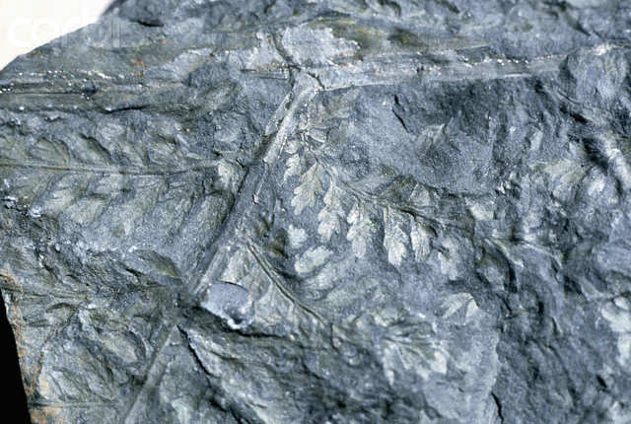
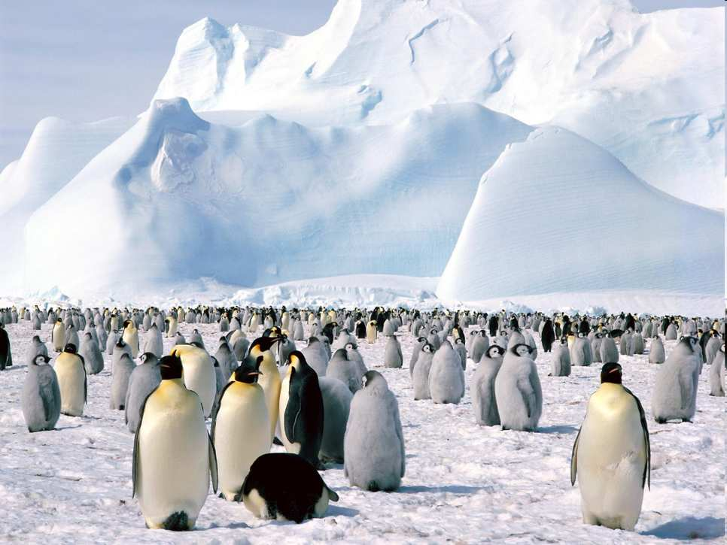
This is a fossilized tropical plant found on Antarctica.
Copyright © 2010 Ryan P. Murphy

Slide 24
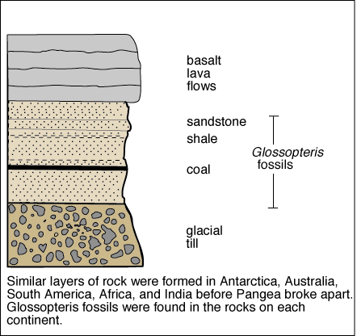
Other ideas that supported Wegener
Geologic records:
nearly identical
rock layers on
continents that
would have fit
together.

Slide 25
Distinctive belts of rock in S. America would align with similar ones in Africa, without the Atlantic.

Slide 27
The distribution of late Paleozoic glacial deposits on present-day Earth are hard to explain. But on Pangae, areas with glacial deposits fit together in a southern polar cap.

Slide 29
If the Atlantic didn’t exist, Paleozoic mountain belts on both coasts would be adjacent.

Slide 30
A modern reconstruction showing the positions of mountain belts in Pangae. Modern continents are outlined in white.

Slide 32
Wegener gets denied
Alfred Wegener had a major hole in his theory… He could not explain how, why, or when this occurred.
Wegener proposed that the spinning of the Earth somehow caused the continents to move, and they had ‘plowed’ through the oceans.

Slide 33
Wegener gets denied
This idea was quickly shot down by physicists and geologists.
The Earth spinning cannot cause less dense continental crust to plow through more dense and rigid oceanic crust.

Slide 34
Wegener gets denied
Wegener’s idea was rejected by the scientific community and would not be revisited until after his death in 1930.

Slide 35
mantle convection cell and continental drift.wmv :45
https://www.youtube.com/watch?time_continue=8&v=p0dWF_3PYh4
Wegner animated 7:52
https://www.youtube.com/watch?v=RgJZ0ySEKYg
How Earth will look in 250 million years 1:00
https://www.youtube.com/watch?v=hos7w8xrcEs

