Slide 1
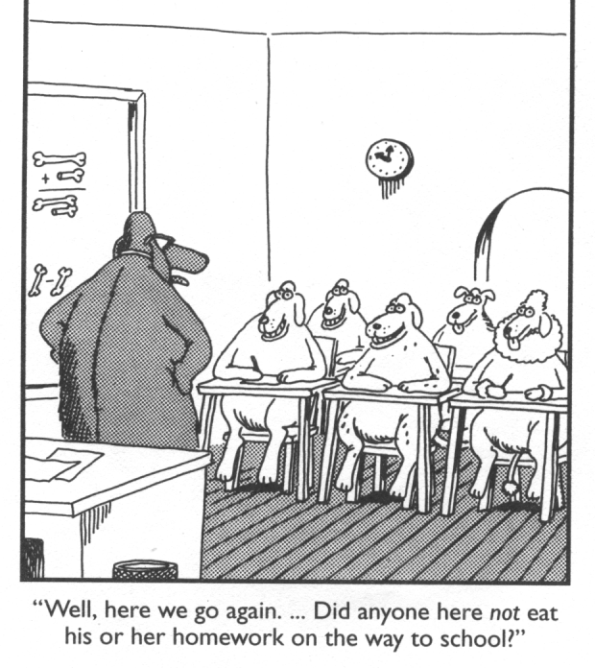
Hedrick
Middle School
WELCOME TO
LIFE SCIENCE
MRS. BECKY PLANKENHORN

Slide 2
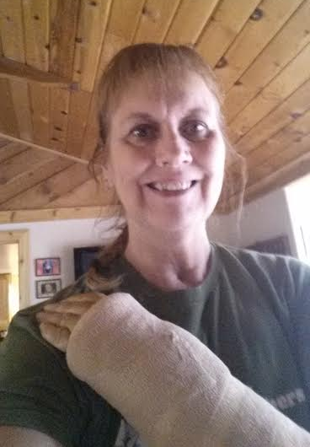
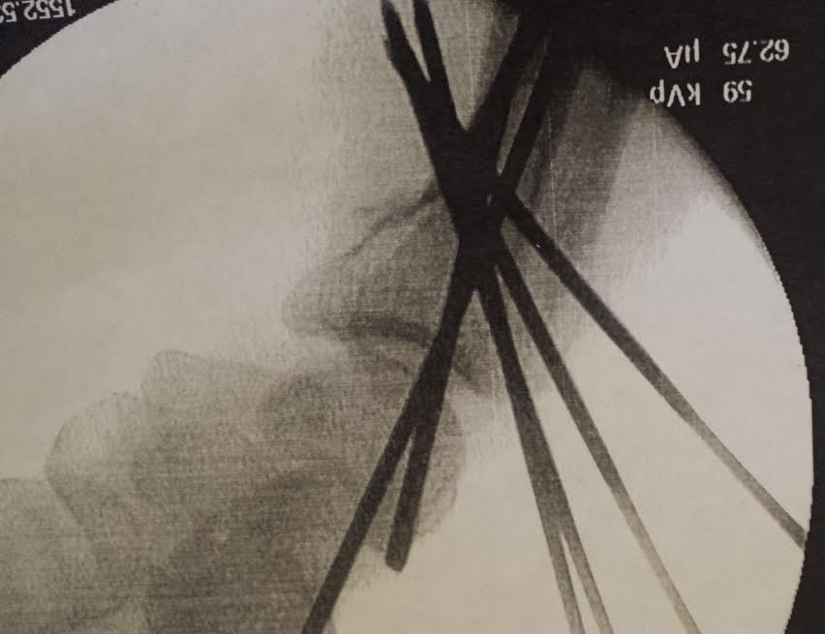
Yikes-the best selfie I could take.
Can’t wait to get back to my favorite place---the classroom---where I learn something new each and everyday from your amazing children!

Slide 3
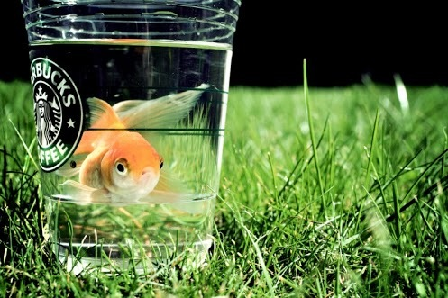
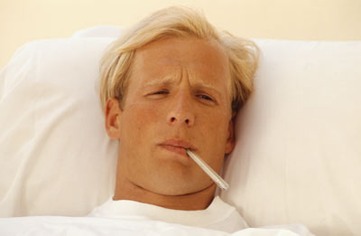
You are given a goldfish and a thermometer.
How are you going to take the goldfish’s temperature?

Slide 4
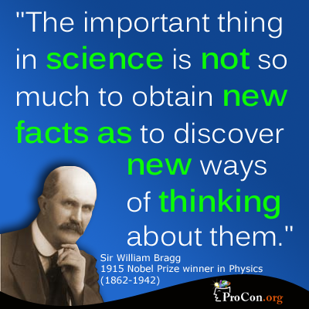
My job is to inspire your child to learn by asking them the right questions.
I have a LOVE of science that I want to instill in your child!

Slide 5
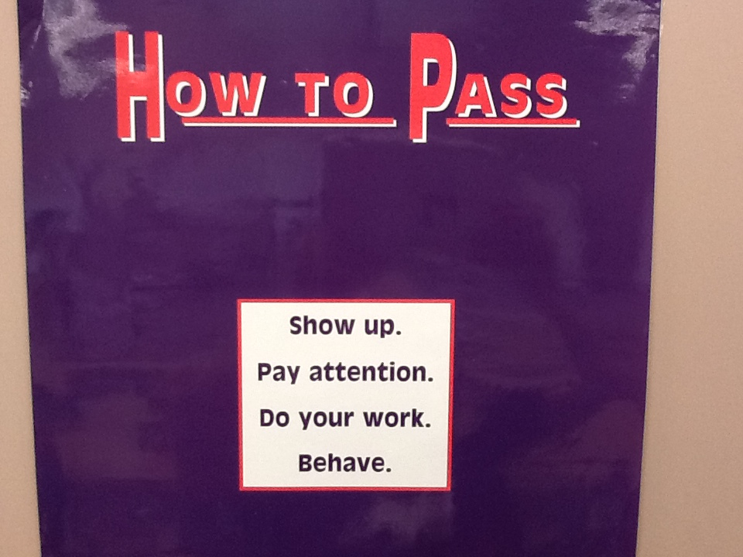

Slide 6
PROFICIENCY…WHAT IS IT?
THE ROAD TO LEARNING
We know that ALL students are capable of learning. What I like about proficiency is---- if a student puts in the time and effort, they CAN receive passing grades in my class.

Slide 7
PROFICIENCY…WHAT IS IT? THE ROAD TO LEARNING
Let’s look at the end of a two week science unit at which time there is a unit test (summative assessment) and one of the following has taken place in your child’s life—3 days prior to the test:
absent for 3 days due to illness
emotional time in family life
family activities or events consumed study time at home
Do you think your child will pass the test?

Slide 8
PROFICIENCY…WHAT IS IT? THE ROAD TO LEARNING
What has happened in the past if your child did not pass a test?
Usually, the class just moves on to the next unit and your child is thinking, “Wow, I blew that one, so why even keep trying…I don't even understand it.”
However, the magic in Proficiency
------------it is not too late.
The “learning” is still available for your child. He/She is expected to learn the material and retake the test (different test—same content).

Slide 9
PROFICIENCY…WHAT IS IT? THE ROAD TO LEARNING
How does your child accomplish this:
Get needed help by making an appointment to see me at lunch, before or after school, or during APP (study hall—7th period).
Complete all classwork.
Read and study the appropriate textbook section, classwork, and study guide.
Complete the Unit Study Guide and have you sign it—indicating that he/she is ready to reake the test.
Your child and I will arrange a time (usually during APP) to retake the test.

Slide 10
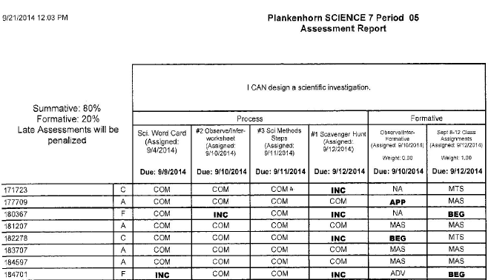
PROFICIENCY…WHAT IS IT? THE ROAD TO LEARNING
After 4 or 5 classwork assignments have been completed, I create a “formative” assignment which is graded on the completion of classwork. This counts as 20% of overall grade.
The unit test is called a summative assessment and counts as 80% of the overall grade.
Short check up/quiz to see how your child is doing with one of the concepts. Note: 0.00 weight toward grade.
Does Not affect overall grade
CLASS WORK/Assignments
Complete/Incomplete
3 out of 4 completed = C
2 out of 4 = F
All classwork completed = A

Slide 11
PROFICIENCY…WHAT IS IT? THE ROAD TO LEARNING
Note that the 20% formative grade for completed assignments can change----the grade will improve as incomplete work is turned in---as I will input a change for that grade.

Slide 12
 | Mastery | Advanced | Meets | Approaching | Beginning
I CAN distinguish between living and nonliving things based on characteristics. | Thoroughly describe & distinguish the characteristics that set living things apart from nonliving things. | Mostly describe & distinguish the characteristics that set living things apart from nonliving things. | Somewhat describe & distinguish the characteristics that set living things apart from nonliving things. | Struggling to describe & distinguish characteristics that set living things apart from nonliving things. | Wasn’t able to or didn’t make an attempt to describe & distinguish characteristics that set living things apart from nonliving things.
The following statements are how to obtain an Advanced or Meets toward this Learning Target:
o List the six characteristics of living things.
o Define the words, STIMULUS, METABOLISM and HOMEOSTASIS.
o Compare and contrast asexual and sexual reproduction.
o Explain how living things obtain what they need to live.
To show MASTERY toward this Learning Target, you need to obtain an Advanced on the above and thoroughly and accurately answer the Mastery statements below:
o Be able to explain why something is nonliving based on the characteristics of living things.
o Be able to compare and contrast how decomposers, consumers and producers are categorized.
Where do they come up with these words?
Your student receives a Rubric & Capacity Matrix at the beginning of each unit. This will tell you and your child exactly what they need to know to receive a passing grade on the unit.

Slide 13
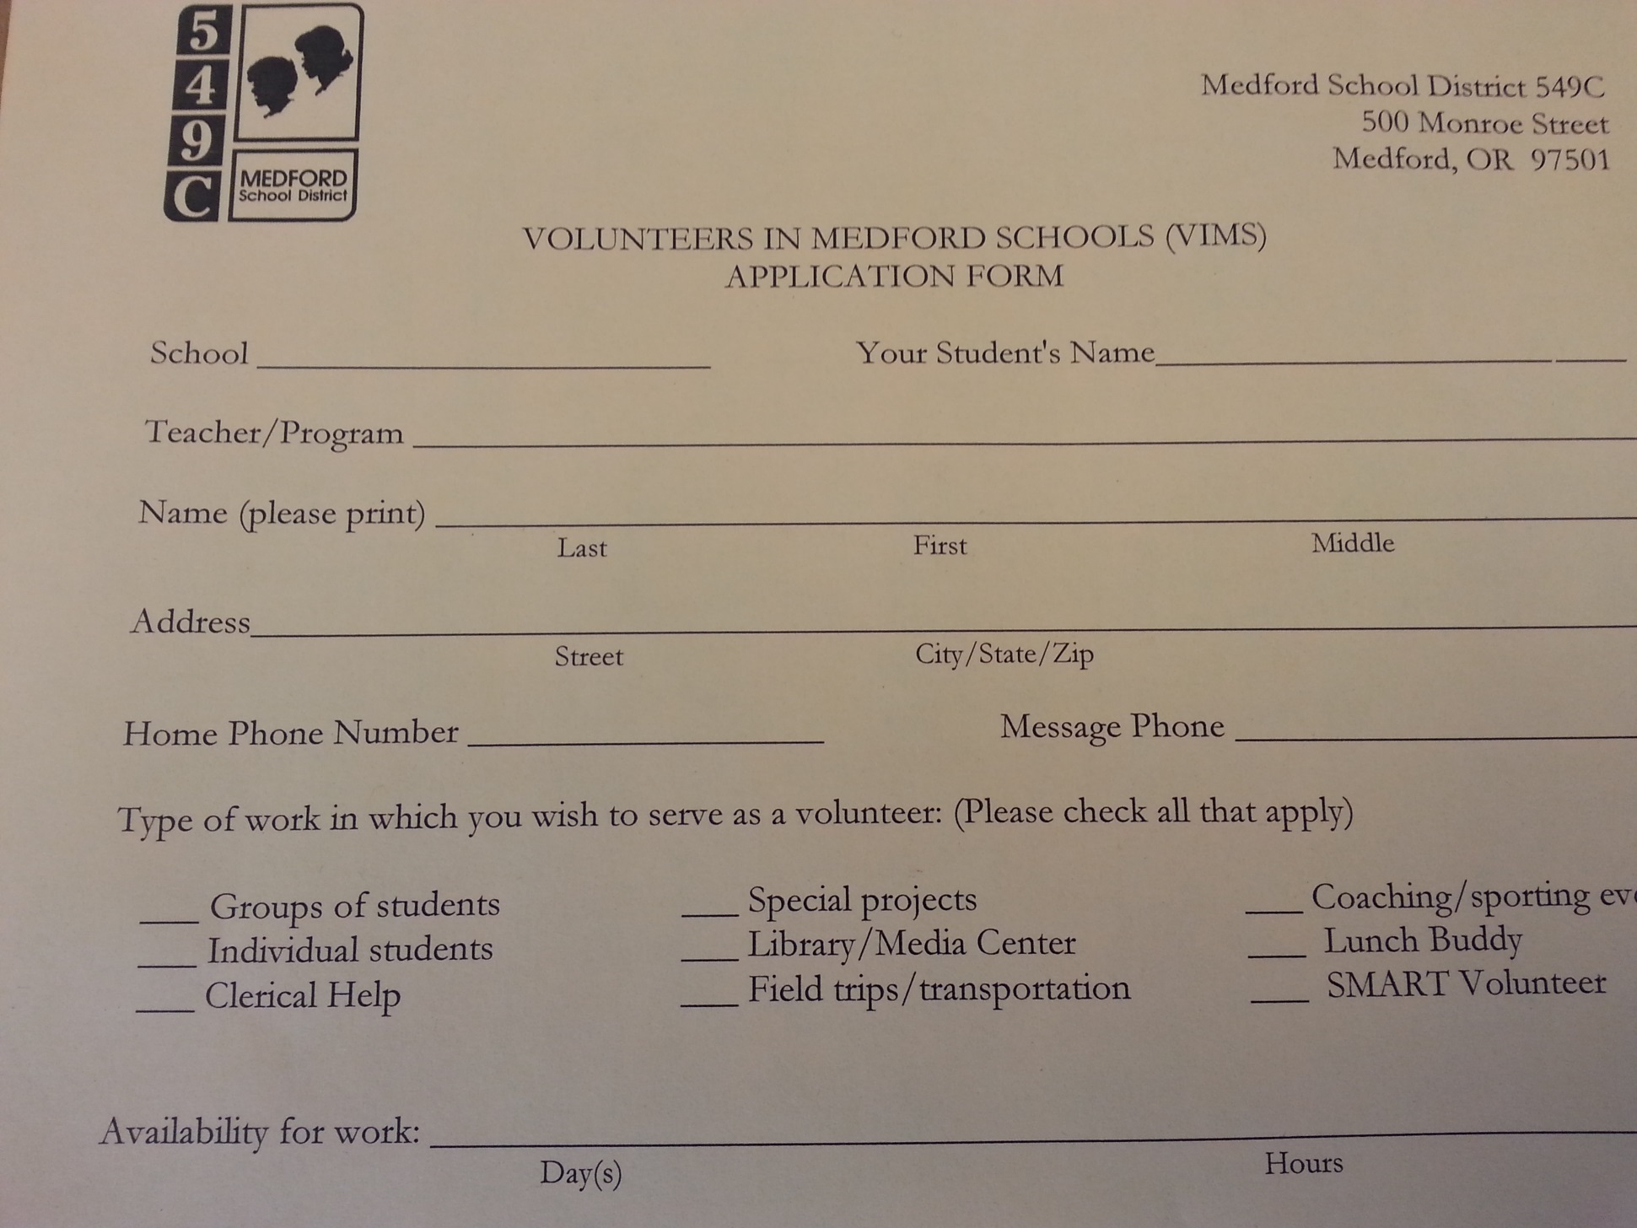
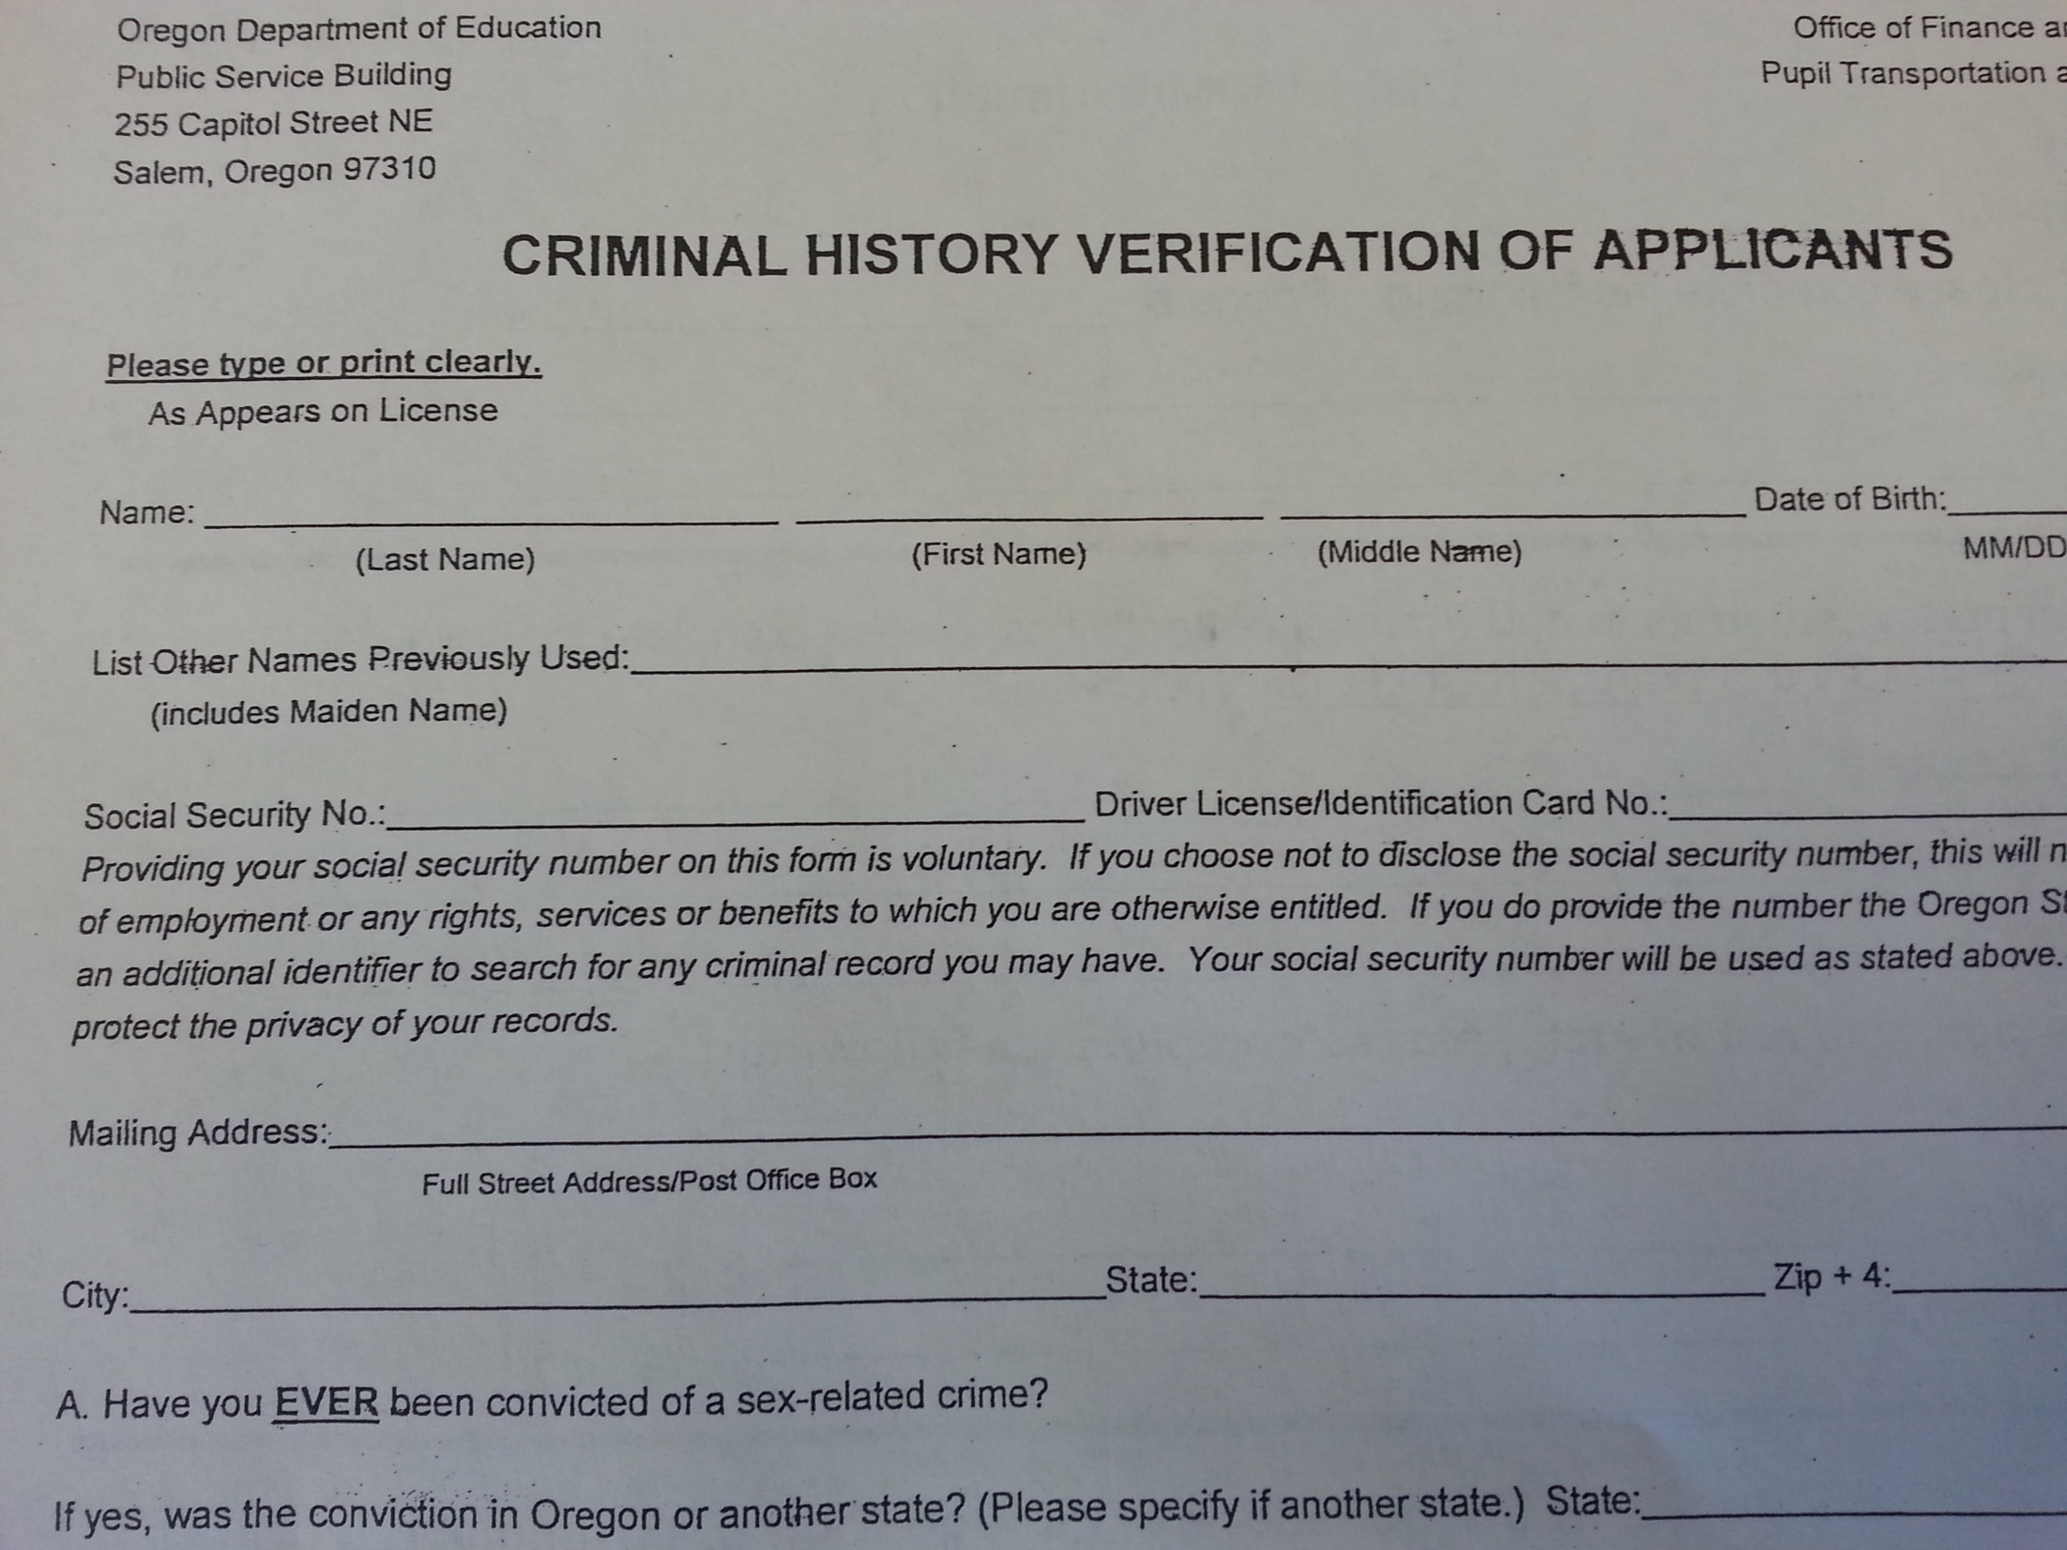
VIMS and CRIM
FIELD TRIPS
These forms need to be turned in to the office at least 2 weeks BEFORE an upcoming field trip.

Slide 14
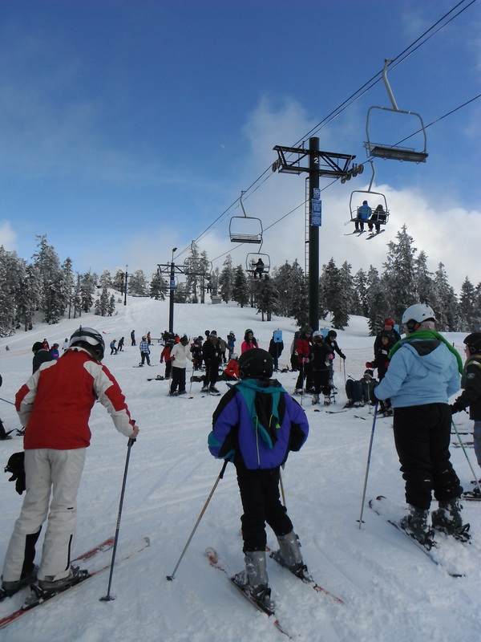
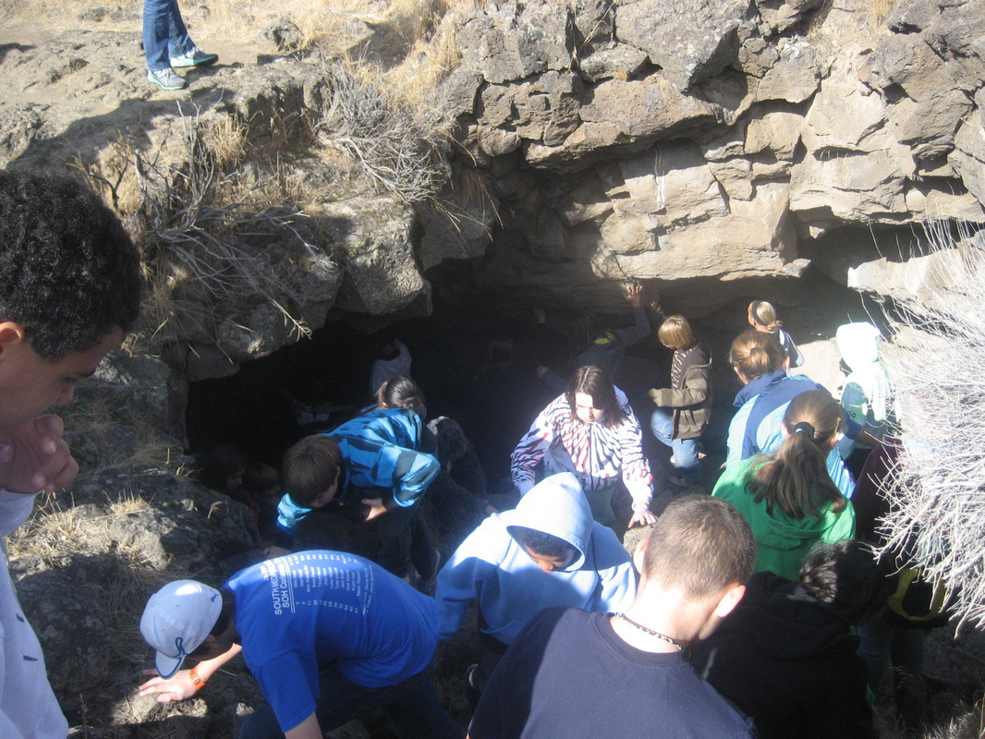
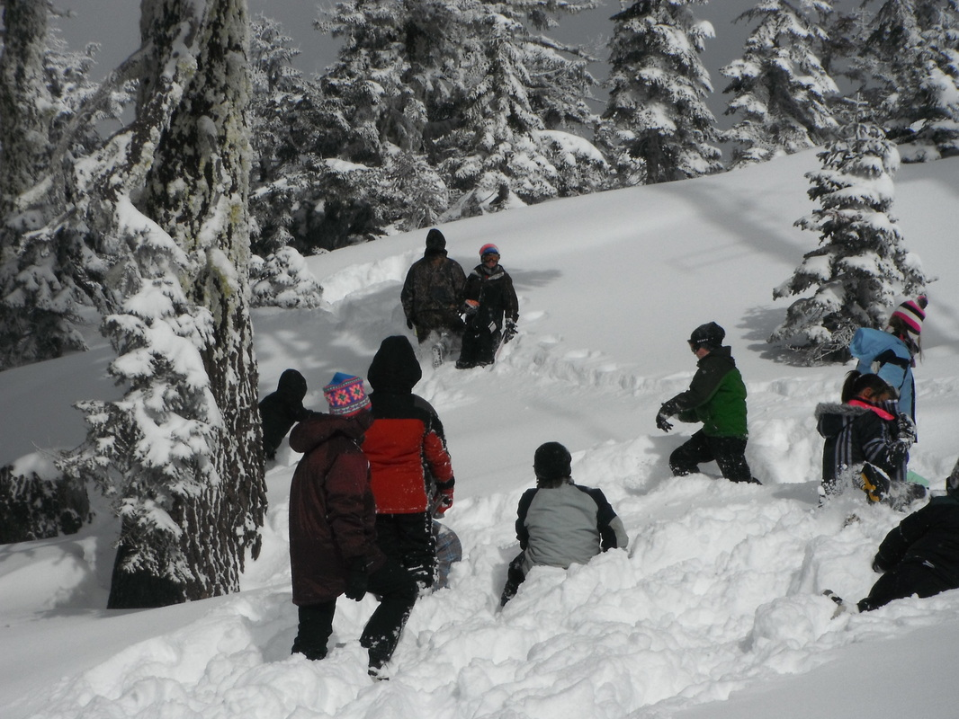
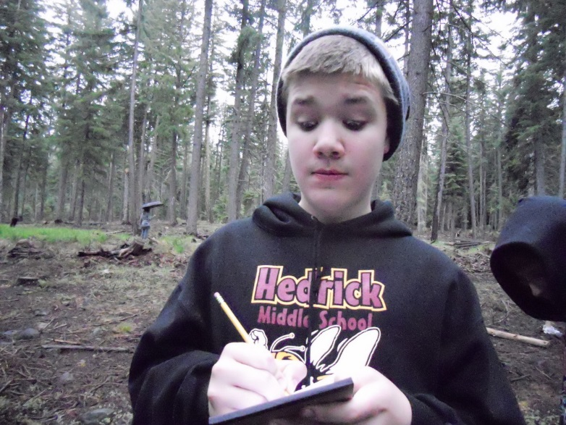
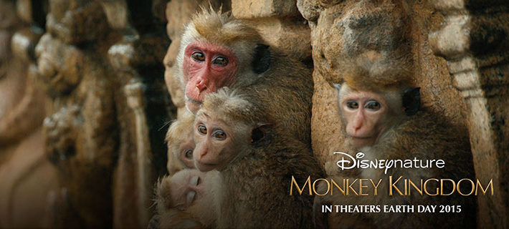
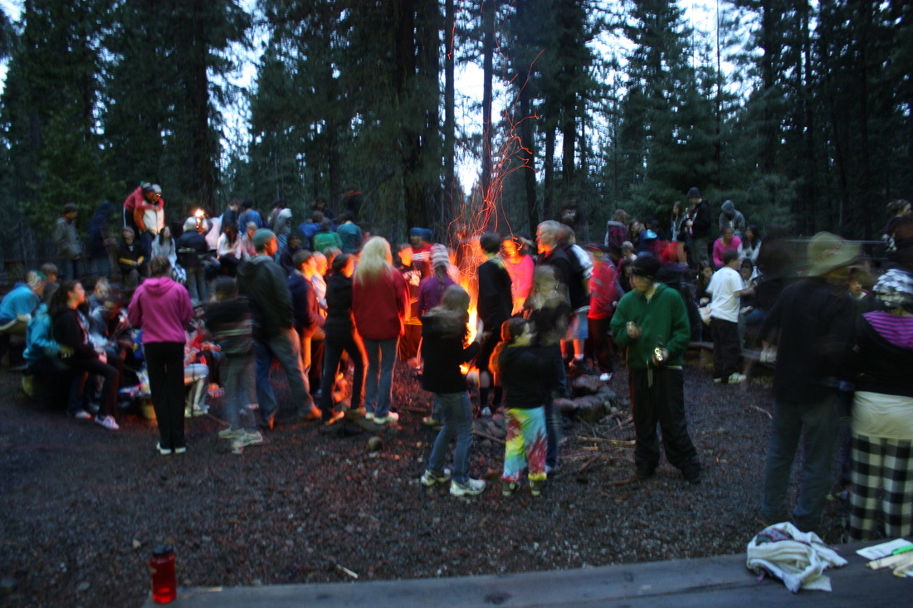
FIELD TRIPS
09/25 Fort Vanoy Farms in Grants Pass
Oct. Lava Beds National Monument—Full Day
Jan. Mt. Ashland Snow Activities and Skiing—Full Day
April Earth Day Disney Nature’s MONKEY KINGDOM
–movie
05/28-29 2-Day-Overnight to Mtn. Lakes

Slide 15
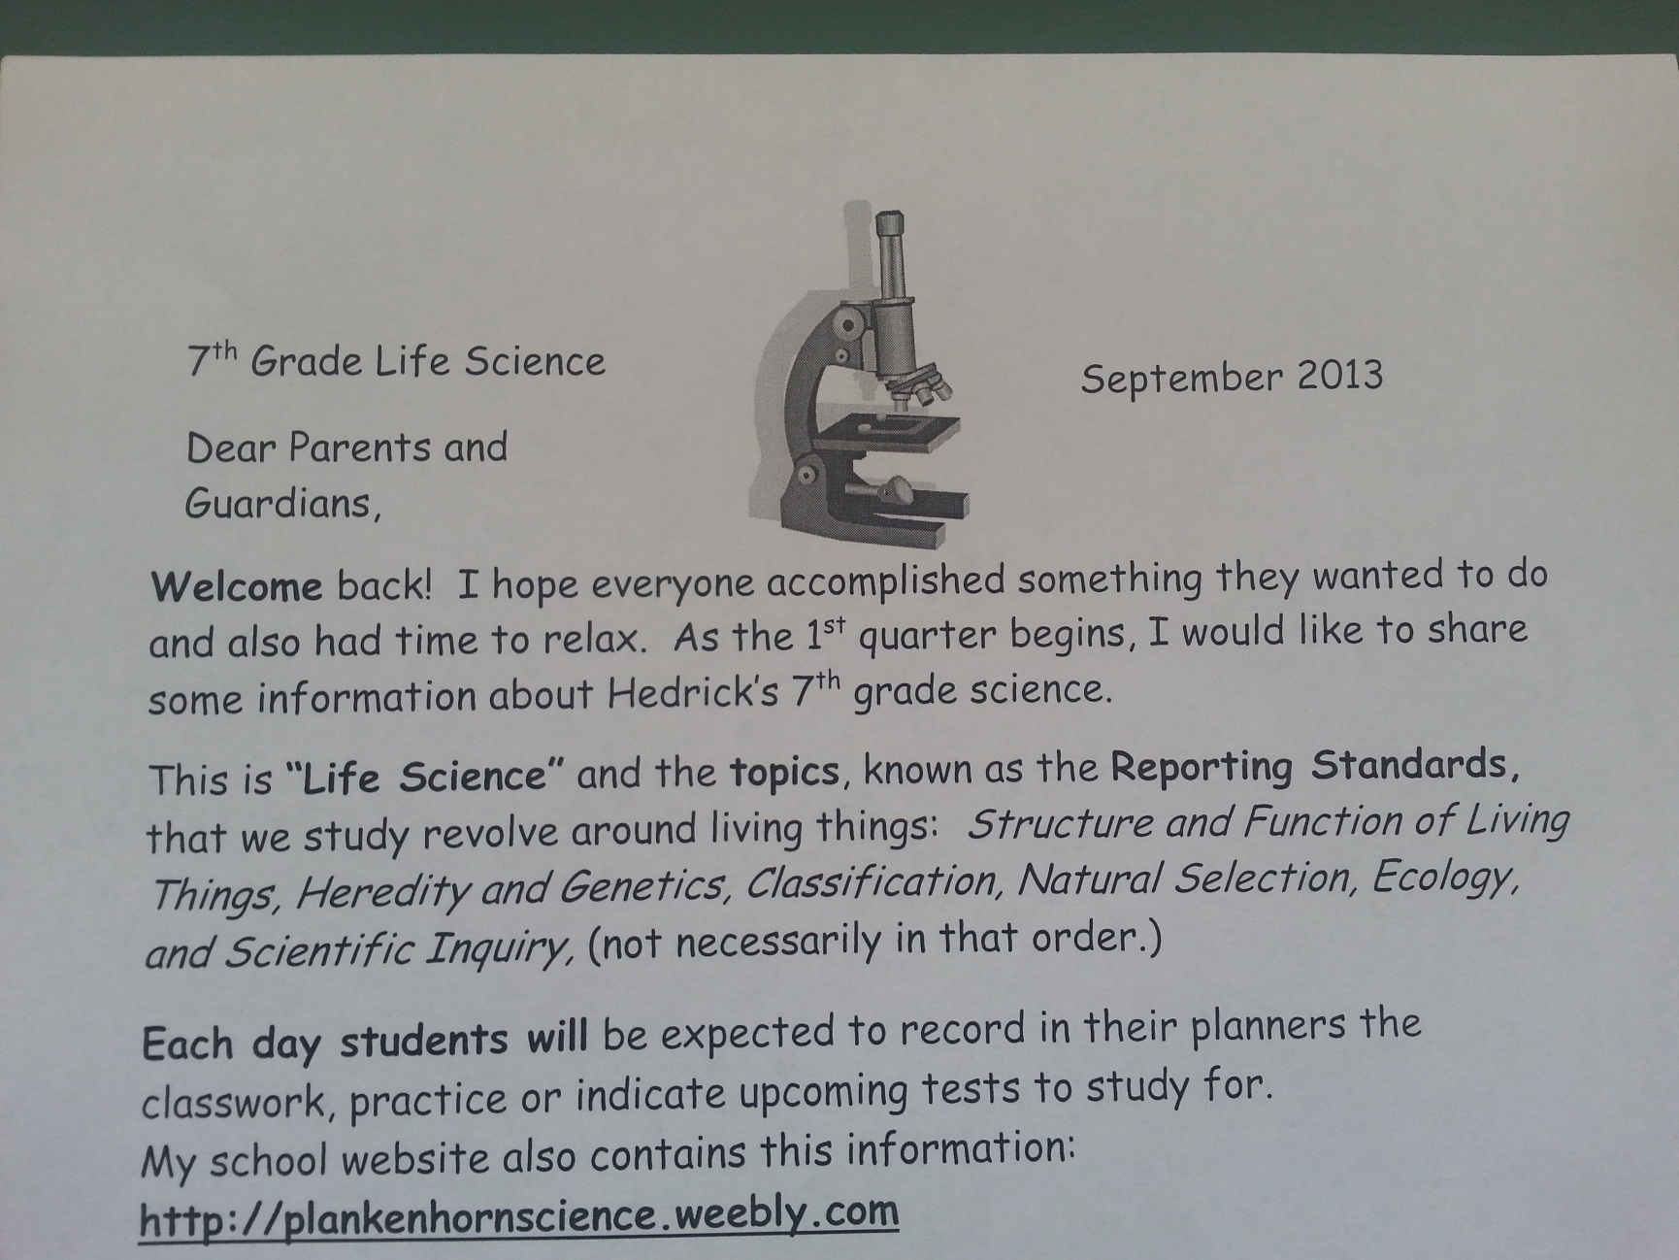
Review Parent Letter. . .
PROFICIENCY…WHAT IS IT? THE ROAD TO LEARNING
http://plankenhornscience.weebly.com

Slide 16
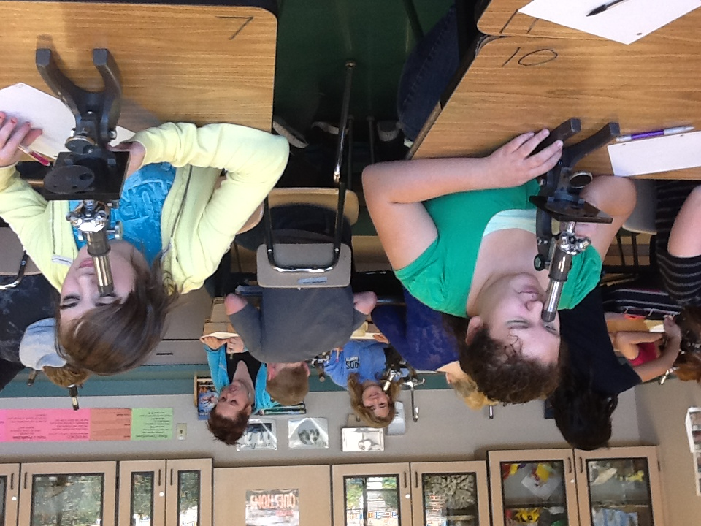

Slide 17
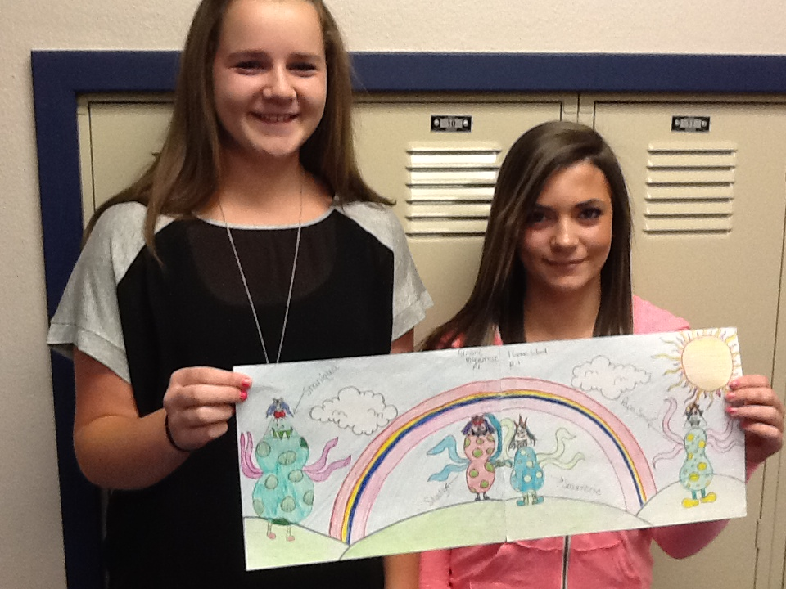

Slide 18
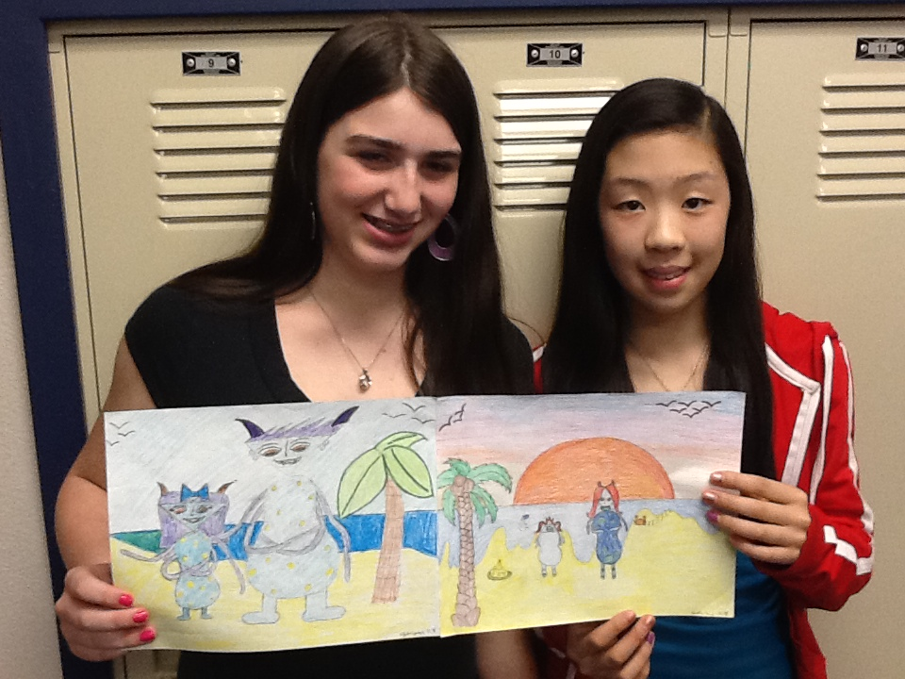

Slide 19
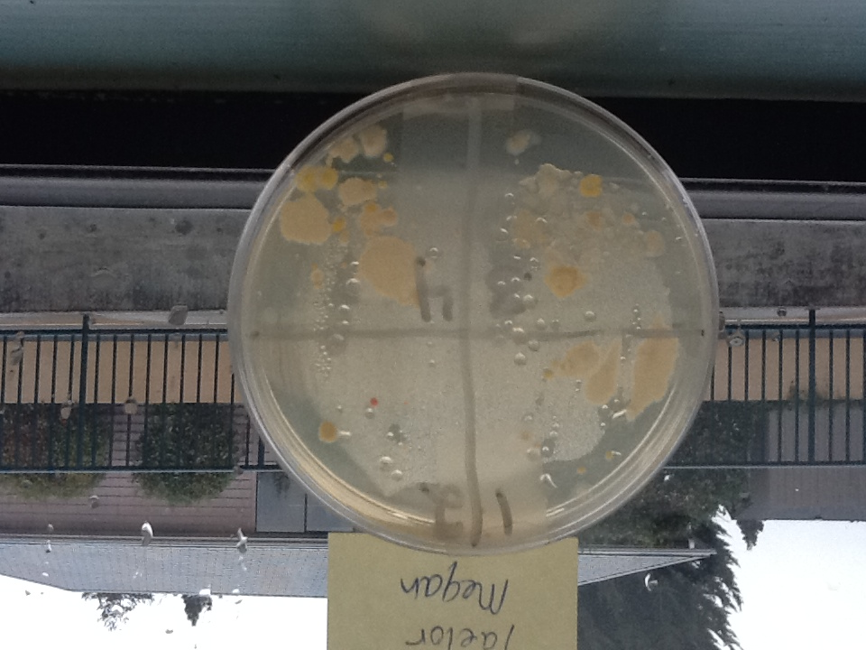

Slide 20
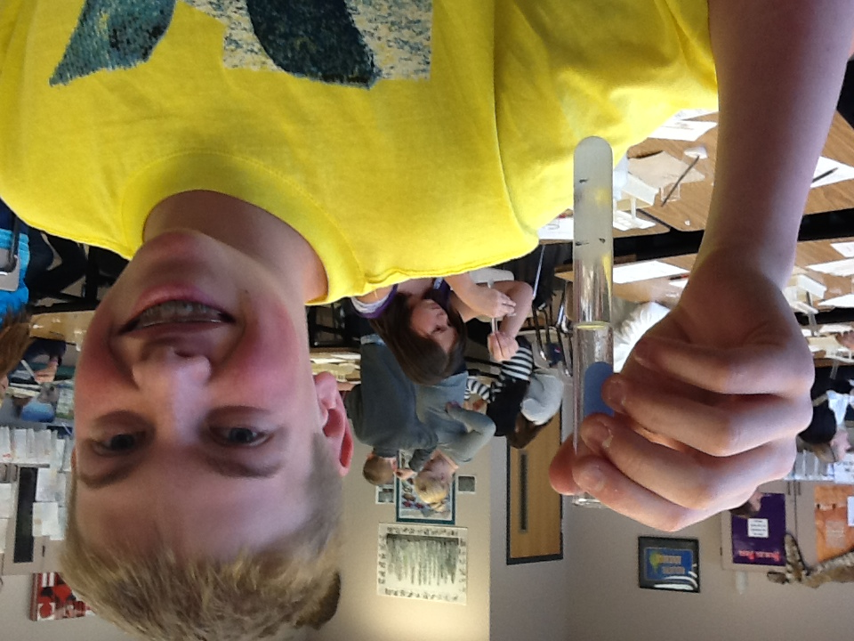

Slide 21
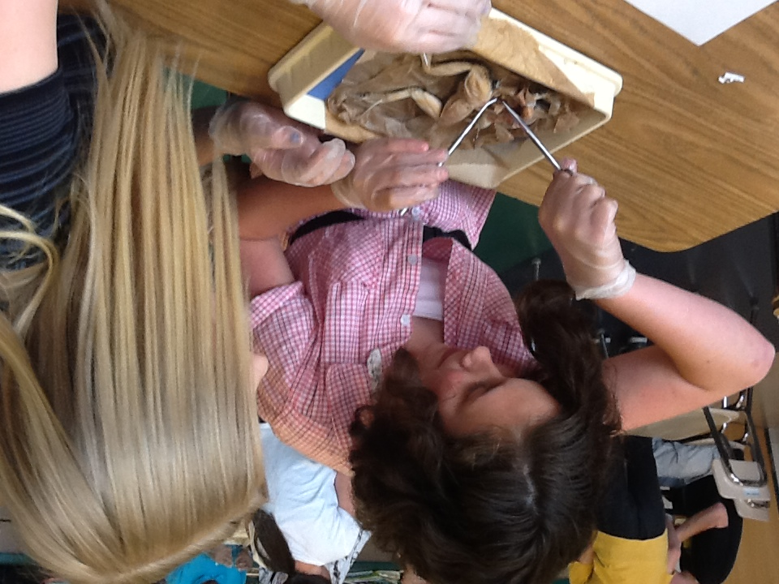

Slide 22
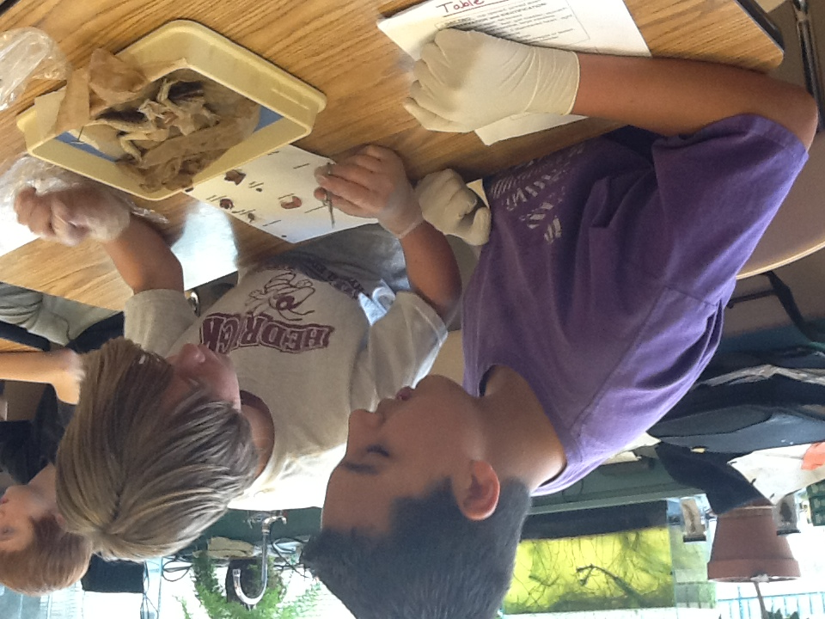

Slide 23
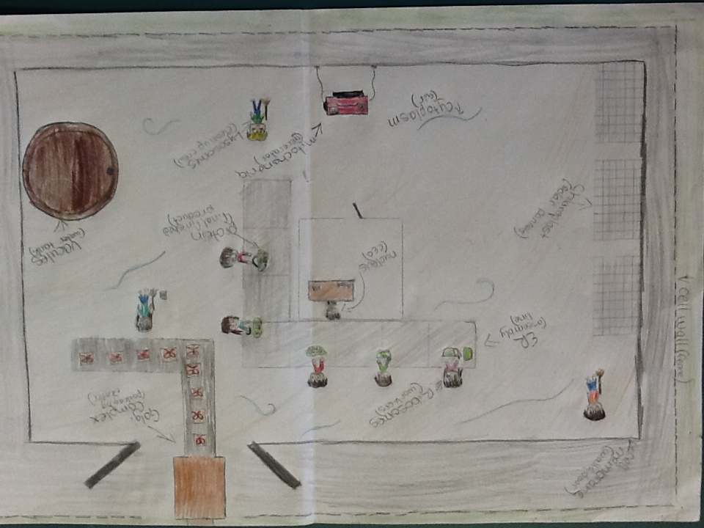

Slide 24
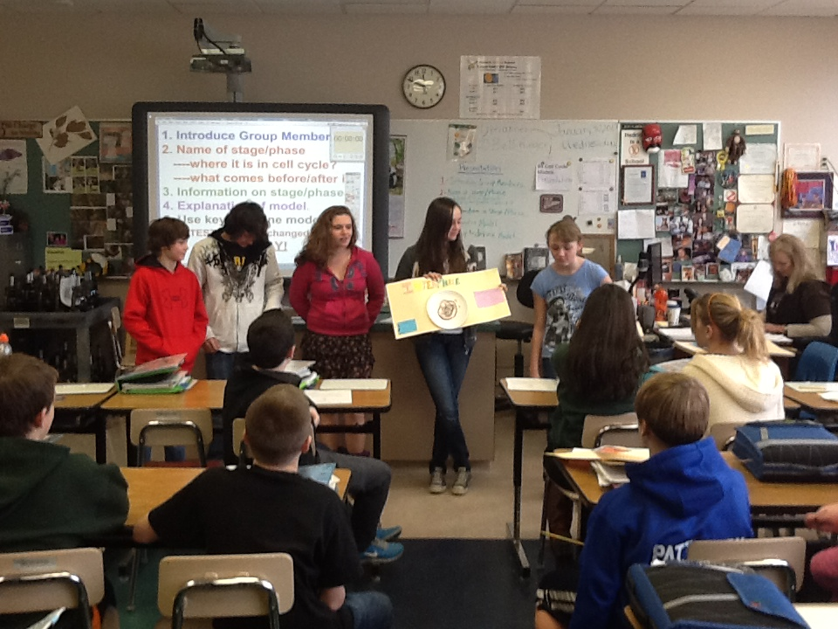

Slide 25
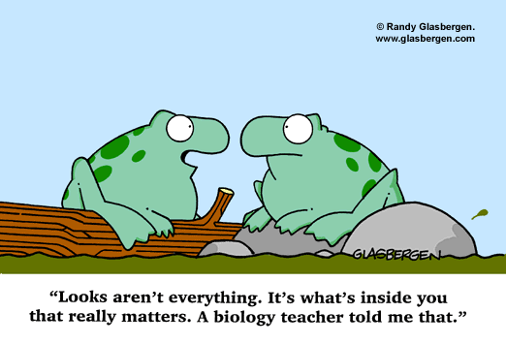

Slide 26
Humpty Dumpty’s Final Resting
Place

