Slide 1



Bell Ringer 9/09
Decode the picture
Example—this means
One in a million
3.
1.
2.
NOON LAZY
Get out Friday’s
“Cracking the Code.”

Slide 2
Crack the Code. . .
See if you can solve the cryptogram, you may get help from someone sitting near you.

Slide 3
Did you CRACK THE CODE?
Science is built up with facts, as a house is with stones but a collection of facts is no more a science than a heap of stones is a house. Poincare
Talk with your elbow partner about what you think this means and then write one of the ideas at the bottom of your paper.

Slide 4
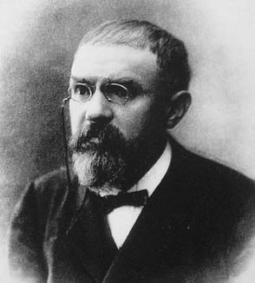
Jules Henri Poincare (1854-1912)
Distinguished scientist and mathematician.
Poincare stated
that the aim of
science is prediction
rather than explanation.

Slide 5
Science comes from Latin
Latin “scientia” means knowledge.
Webster’s dictionary defines science as “knowledge attained through study or practice.”

Slide 6
Observation & Inference
http://mysciencelessons.blogspot.com/2009/07/mystery-footprints-observation-vs.html

Slide 7
Observations
Any information collected with the senses.
    Quantitative – measureable or countable
        3 meters long
        4 marbles
        50 kilograms
        35 degrees Celsius
    Qualitative – describable, not measureable
        red flowers
        smells like fresh baked cookies
        Tastes bitter
The skill of describing scientific events

Slide 8
Inference
Conclusions or deductions based on observations.
The process of drawing a conclusion from given evidence.
Practice:
Observations:
  I hear people screaming
  I smell cotton candy, popcorn, and hamburgers
  I see a lot of people
Inference = ?

Slide 9
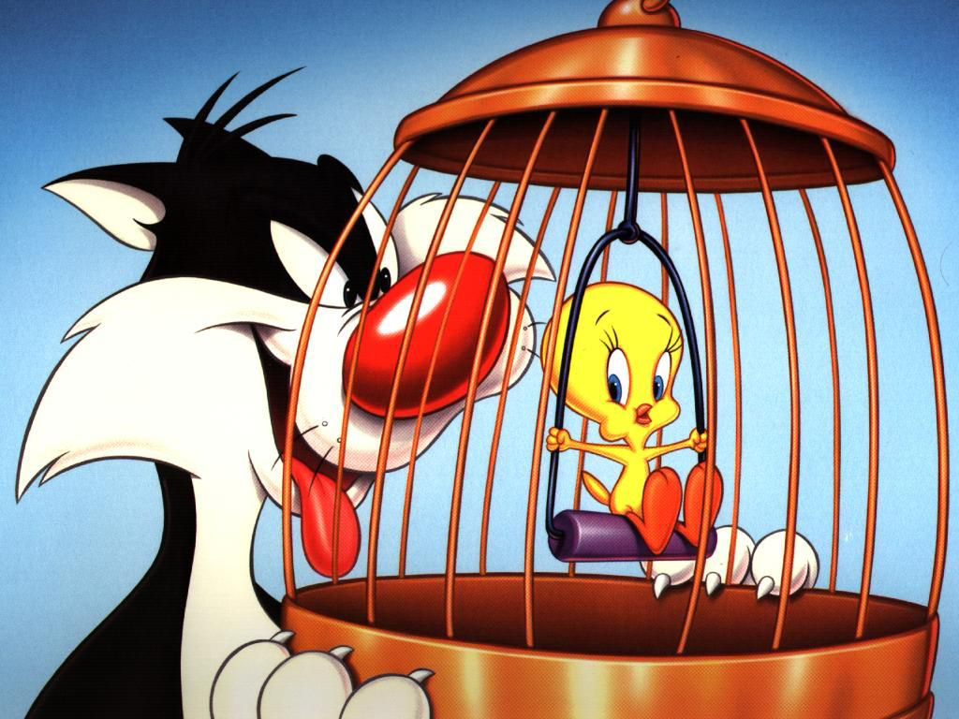
Observation Inference

Slide 10
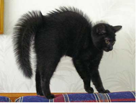
Observation Inference

Slide 11
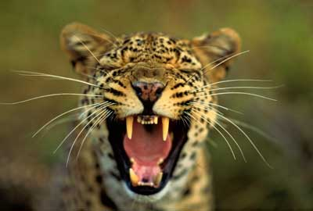
Observation Inference

Slide 12
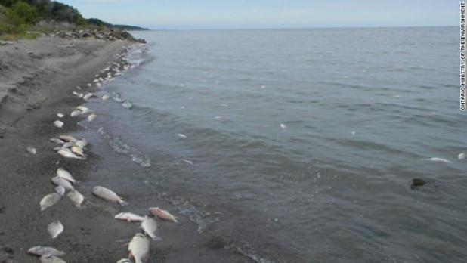
Observation Inference

Slide 13
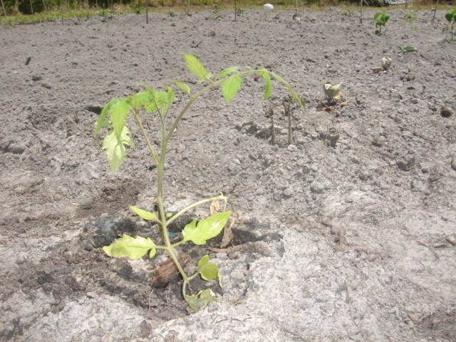
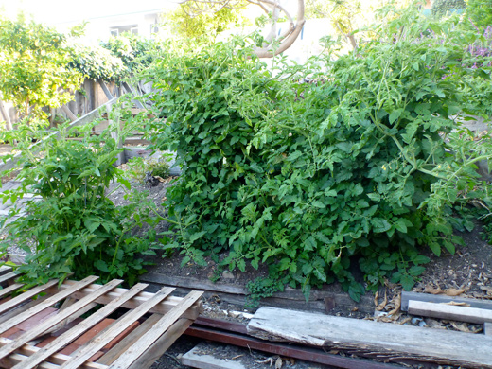
Observation Inference

Slide 14
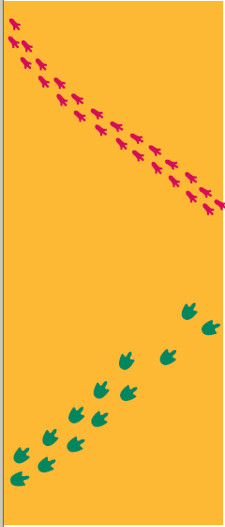
Look at these two sets of animal tracks.
List 3 OBSERVATIONS
Make an INFERENCE

Slide 15
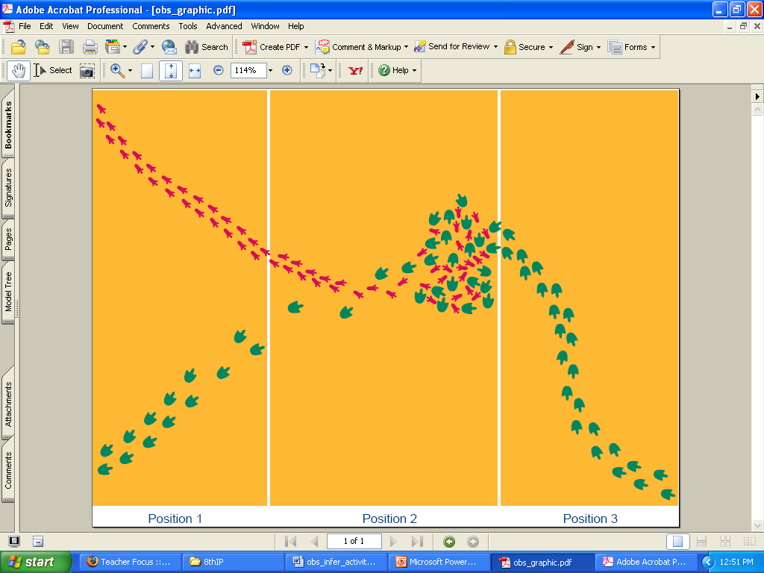
Now what do you think?
Make 3 OBSERVATIONS
Make an INFERENCE

Slide 16
Now what do you think?
Make 3 OBSERVATIONS
Make an INFERENCE

Slide 17
ARE YOU READY TO MAKE AN
OBSERVATION FROM A VIDEO?
COUNT HOW MANY TIMES THE PLAYERS WEARING WHITE PASS THE BASKETBALL.

