Slide 1
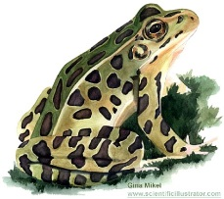
Amphibians Reptiles
Body Covering moist skin tough skin
Fertilization of external internal
Eggs
Reproduction wet eggs eggs in
tough shell
Breathing gills/lungs lungs
Heart Structure 3 chamber 3 or 4
Blood Temp. ectotherm ectotherm

Slide 4
“Notes-May 9:”
Write everything in red:
ventral-belly side:
dorsal-back side:
thumb pads:
4 digits-forelimb--- 5 digits-hindlimb
no ribs:
nictitating membrane:
Tympanum:
mouth-tongue:

Slide 5
Continue writing on “Notes:”
Eustachian tube:
maxillary teeth:
vomerine teeth:
Glottis:
eye bulges:
Gullet:

Slide 6
FROG
LATIN meaning
KINGDOM _____________
PHYLUM ____________________________
CLASS ___________________________
ORDER _______________________________
FAMILY _____________________________
ANIMALIA
CHORDATA
AMPHIBIA “double life”
ANURA “without a tail”
Ranidae

Slide 7
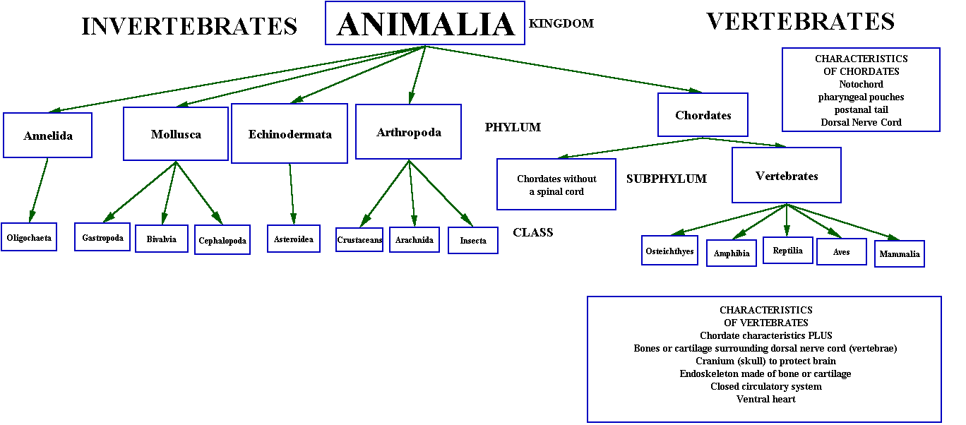

Slide 8
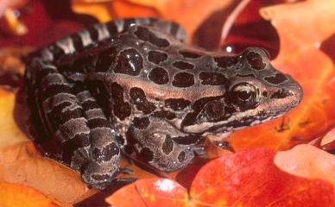
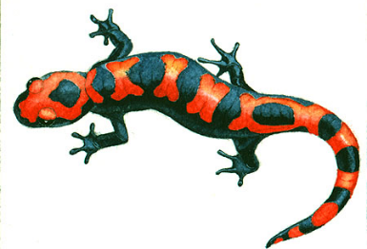
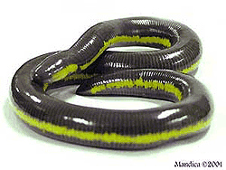
http://users.erols.com/jkimball.ma.ultranet/BiologyPages/V/Vertebrates.html
http://www.spekulantenguide.de/gifs/salamanderw.jpg

Slide 9
AMPHIBIAN CHARACTERISTICS
Moist, thin skin without scales
Aquatic larva changes to terrestrial adult
Feet without claws
Respiration with gills, lungs, skin, mouth
Closed 2 loop circulation
Ectothermic (cold blooded)
Eggs without shells or multicellular membranes

Slide 10
FROGS
Thin, moist skin – no scales
Mucous glands make it “slimy”
Camouflage- for protection
Some have poison glands
http://www-binf.bio.uu.nl/dutilh/hall/kikkers.html

Slide 11
http://www.tvdsb.on.ca/westmin/science/snc2g1/frogresp.htm
BREATHING THROUGH SKIN is called CUTANEOUS RESPIRATION

Slide 12
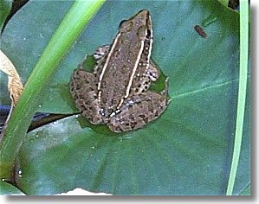
ECTOTHERMIC “cold blooded”
Body temperature is dependent on surrounding environment
http://www.vanscyoc.net/randy/garden/wildlife/image4.htm

Slide 13
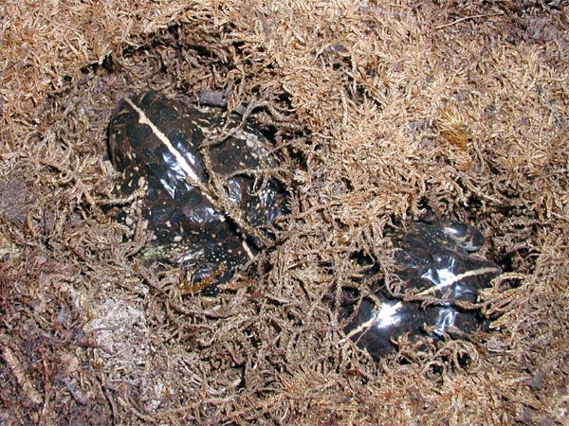
HIBERNATION/ ESTIVATION
FAT stored in FAT BODIES provides energy
Images from:
http://www.enc.org/Classroom_Calendar/CC_Units/Unit_Images/185.jpg
http://www.reptilis.org/pyxi/image5.htm

Slide 14
INDIRECT DEVELOPMENT
Grow legs; Lose tail
2 chambers → 3 chambers
1 loop → 2 loops
Breathe w/ gills → lungs & skin
Excrete ammonia → excrete urea
(gills & kidneys) (kidneys)
http://saczoo.com/3_kids/images

