Slide 1
12 Flashcards
Eukaryotic Structure and Function and Analogies

Slide 2
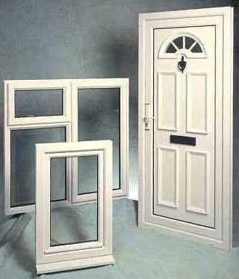
Flash Cards
1 side of card
Cell membrane
Lets things in & out of cell
The other side of card

Slide 3
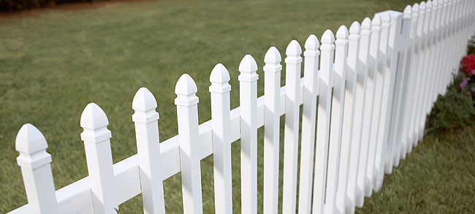
Flash Cards
1 side of card
cell wall
Gives shape & support to
the plant
cell
The other side of card

Slide 4
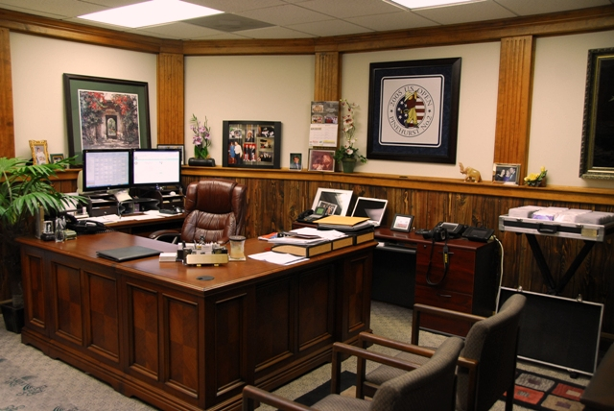
Flash Cards
1 side of card
nucleus
Control center of cell
The other side of card
OFFICE OF THE PRESIDENT

Slide 5
Flash Cards
1 side of card
cytoplasm
Cellular fluid around organelles
Air
The other side of card

Slide 6
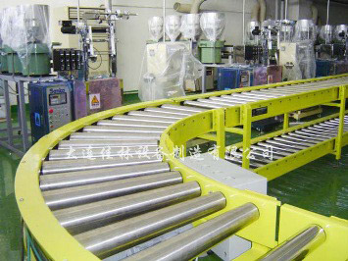
Flash Cards
1 side of card
ER
Where proteins are made for delivery in the cell
The other side of card

Slide 7
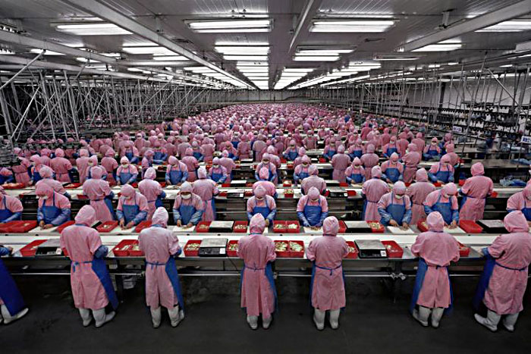
Flash Cards
1 side of card
ribosomes
Make the proteins
The other side of card

Slide 8
Flash Cards
1 side of card
protein
Made by ribosomes & regulates chemical reactions
The other side of card

Slide 9
Flash Cards
1 side of card
lysosomes
Vesicles that digest food particles & wastes
The other side of card

Slide 10
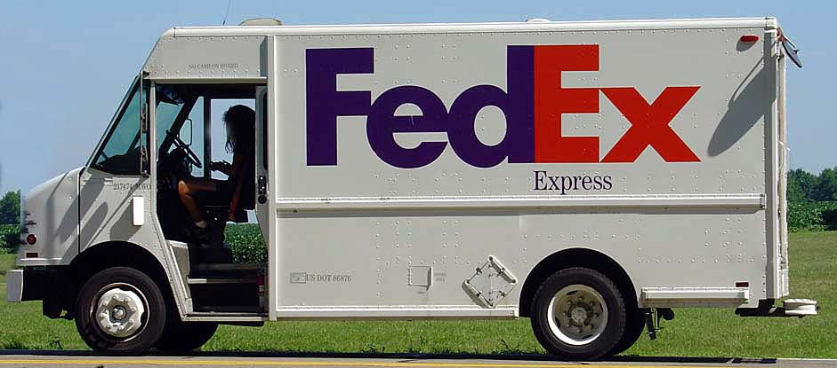
Flash Cards
1 side of card
Golgi complex
Takes proteins out of the cell
The other side of card

Slide 11
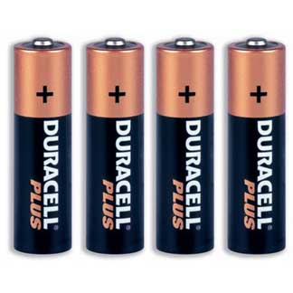
Flash Cards
1 side of card
mitochondria
Breaks down food molecules to make energy
The other side of card

Slide 12
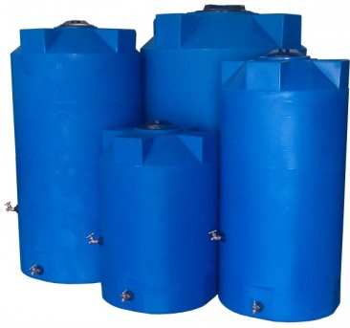
Flash Cards
1 side of card
vacuoles
Storage container for water-large in plants
The other side of card

Slide 13
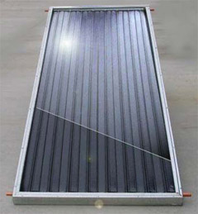
Flash Cards
1 side of card
chloroplast
Where sugar is made- occurs-in
plants & algae
The other side of card

